Slide 1
U.S. History Post WWI: The 1920s
Dr. Donnelly

Slide 2
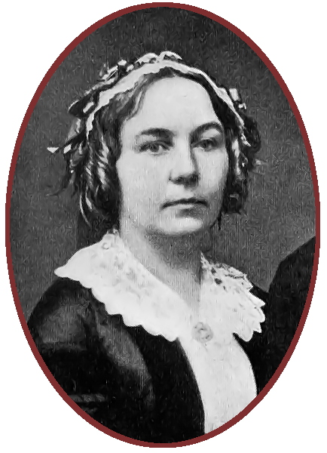
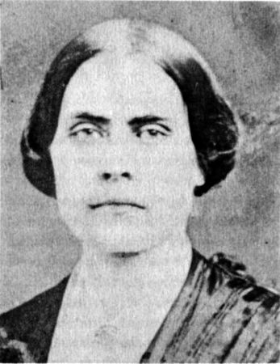
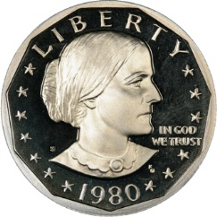
Women’s Suffrage: Origins
Women’s suffrage movement began with leaders Elizabeth Cady Stanton & Susan B. Anthony.
First formal demand for women’s suffrage was the Seneca Falls Convention of 1848.
Stanton was an excellent speaker & writer; Anthony organized & planned strategy.
They founded the American Equal Rights Association in 1866.

Slide 3
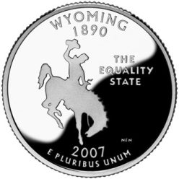
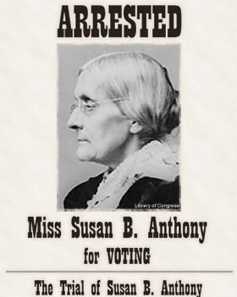
Early Women’s Suffrage Groups ( see #2 on study guide)
Stanton & Anthony soon founded the National Woman Suffrage Association – worked for a constitutional amendment for women’s suffrage across the U.S.
Another group, the American Woman Suffrage Association, worked to win suffrage one state at a time.
Wyoming became the first state to grant women’s suffrage (in 1869).
In 1872, Susan B. Anthony was arrested & convicted of civil disobedience for attempting to vote in New York and refusing to leave polling place when ordered.

Slide 4
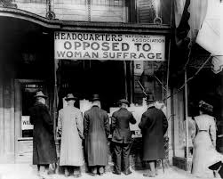
Suffrage at the Turn of the Century (#3 & #5)
In the late 1800s, suffragists had succeeded in getting women the right to vote in several states (mostly in the West), but had no luck in getting a national women’s suffrage amendment – the one state at a time strategy was more effective in the 1800s.
By 1890, married women had full property rights and more women were demanding the right to vote.
But when Elizabeth Cady Stanton died in 1902 and Susan B. Anthony died in 1906, the national women’s suffrage movement seemed “on hold.”

Slide 5
A New Generation of Suffragettes (#6)
Carrie Chapman Catt, Alice Paul, and Lucy Burns became new suffrage leaders. Catt became leader of NAWSA (National American Woman Suffrage Association).
1913 suffrage parade in D.C. led Alice Paul, who was very militant, to create the Congressional Union (CU) as part of NAWSA, which had been formed in 1890.

Slide 6
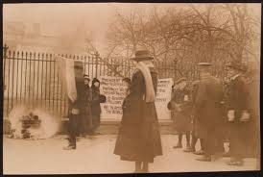
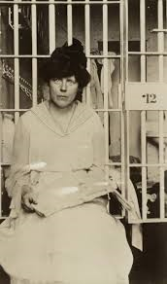
A Split in the Suffrage Movement (#4)
Alice Paul’s CU wanted to be aggressive & militant; burned President Wilson in effigy when he came to D.C. for his inauguration in 1913.
NAWSA didn’t want CU’s militant actions to alienate moderate Americans, so expelled the CU from NAWSA.
CU’s later militant activities landed many members in jail; many CU ladies in jail went on hunger strikes – when some were force-fed by guards, they won public sympathy for the CU.

Slide 7
Progressing toward suffrage (#6, #1, & #3)
Carrie Chapman Catt’s “Winning Plan:” NAWSA would focus all its efforts on getting a national amendment for women’s suffrage.
After 1910, the nationwide strategy worked better than the one state at a time strategy.
Women’s work in WWI strengthened the argument that women could handle the responsibility of voting, so more supported suffrage.
When the 18th Amendment passed (outlawing sale of liquor), liquor interests no longer had reason to fight women’s suffrage.

Slide 8
Victory for Suffrage (#7)
Congress proposed 19th Amendment in 1918.
19th Amendment passed in 1920.

Slide 9
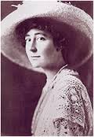
Women Working & Voting (#8, #12)
By the 1920s, more women had jobs, but most were entry-level – few women worked after marrying and starting a family. Overall, their role in the work force was about the same as before.
Even though it was legal now, few women voted, due to family pressure, self-doubt, & inconvenience.
When they did vote, women voted in similar patterns to men; i.e., women were about equally split between Republicans & Democrats, etc.
Some women won political office (Jeannette Rankin was elected U.S. representative for Montana even before the 19th Amendment passed).

Slide 10
Rural-Urban Split
Weak farm market, combined with booming industry in the cities, led 6 million Americans to move from rural to urban areas in the 1920s – first time in U.S. history that more people lived in urban than rural areas.
This migration to the cities doubled enrollment in the U.S.’s urban public schools.
Rural people tended to be more traditional; urban people tended to want change.

Slide 11
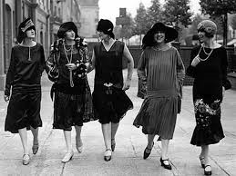
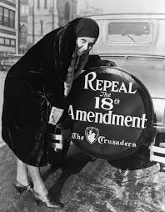
Flappers (#9-11)
Some American women became flappers – represented a change in women’s morals, manners, & fashions (shorter skirts = change in morals & manners).
Flapper culture included dancing to jazz music (the Charleston & the Lindy were two favorite dances), wearing gaudy jewelry, short (bobbed) hairstyles, shorter skirts, drinking alcohol (illegal then because of the 18th Amendment), and smoking cigarettes.
Also had their own slang: if something was “the berries,” or “the cat’s pajama’s,” it was good; “butt me” meant “give me a cigarette,” a divorced woman was called a “fire alarm,” etc.

Slide 12
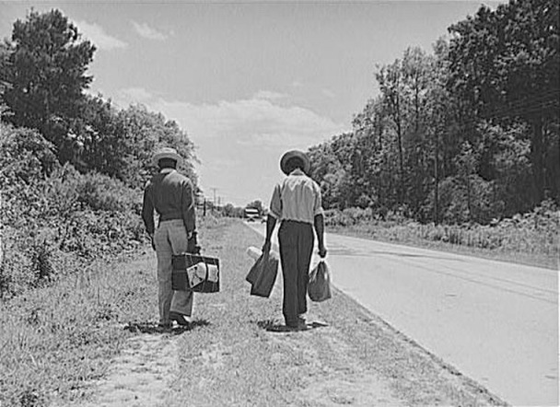
African Americans in the North (#24)
The Great Migration continued as segregation drove many African Americans away from the South; at the same time, there were job opportunities for them in the North.
Still often found only menial manual-labor jobs in the North and faced anger from whites as blacks competed against them for jobs.

Slide 13
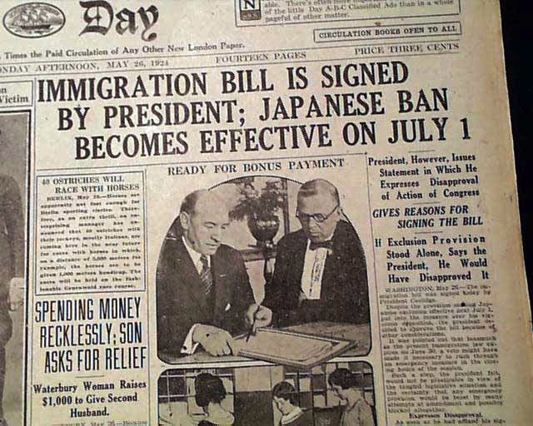
The National Origins Act (#15-16)
The National Origins Act was passed by Congress in 1924 to limit the number of immigrants who could move into the U.S.
The number of immigrants allowed from countries in Asia and eastern & southern Europe was very small (quota of zero for some nations).
Many immigrants were seen as a threat to America.
U.S. began getting more immigrants from Canada & Mexico since the National Origins Act didn’t affect them.

Slide 14
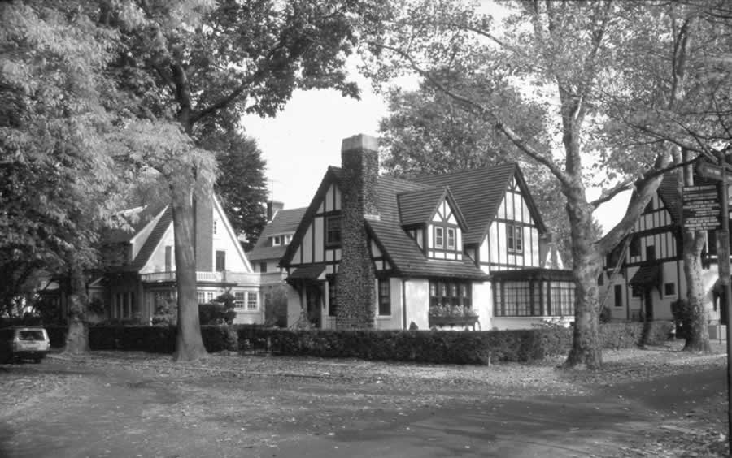
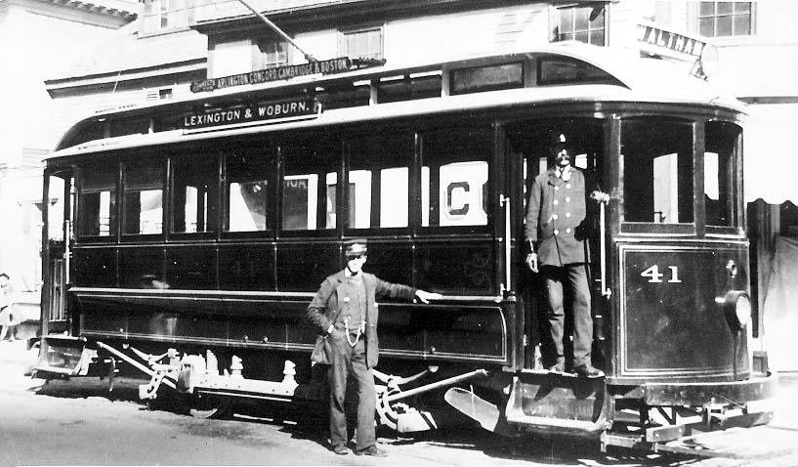
Growth of Suburbs (#19)
Suburbs grew near major cities as buses & cars became common – more professionals moved out of the cities.
Buses replaced trolleys as mass transit in many cities.

Slide 15
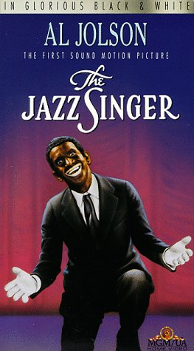
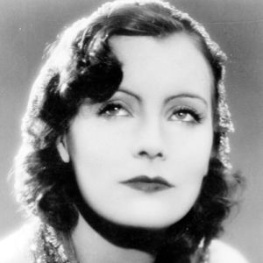
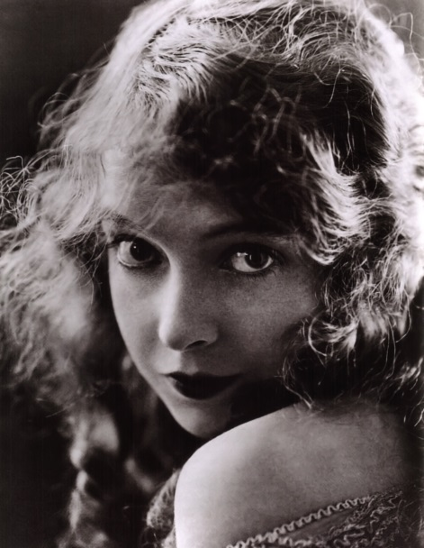
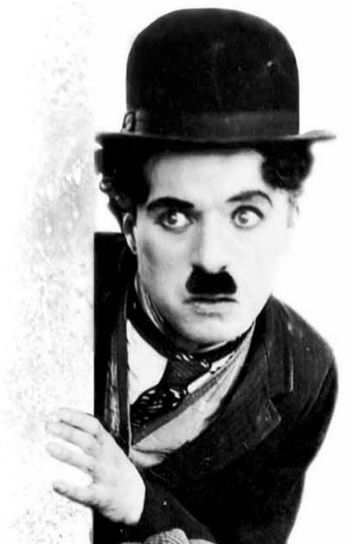
Growth of Mass Media (#21)
Movies: silent films began in the 1890s; “talkies” (movies with sound) began in 1927 with Al Jolson’s The Jazz Singer: Introduction of sound was the big change in movies.
Early movie stars included Greta Garbo, Lillian Gish, and Charlie Chaplin.
Movies were very popular and cheap to attend.

Slide 16
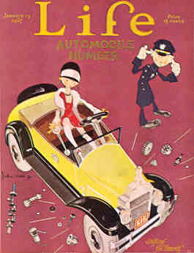
Mass Media: Newspapers & Magazines (#20)
Newspapers got bigger & more popular in the 1920s – many independent papers were bought by chains.
Many newspapers were tabloids that focused on profits, not quality journalism.
National magazines like Life became popular.
Because people in all parts of America read the same articles in magazines & newspapers (and saw the same movies), America developed more of a common national popular culture.

Slide 17
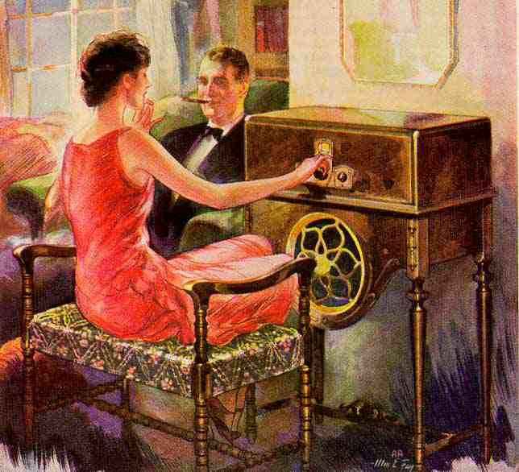
Radio! (#20)
Invented by Marconi in the 1880s, radios were mostly used for 1-on-1 communication until 1920.
The first radio station was KDKA in Pittsburgh; by 1922, there were over 500 radio stations in the U.S.
Networks like NBC radio played the same programs on all their stations, so most Americans heard the same music, news, radio shows, sports, etc., no matter where they lived.
Again, this helped the U.S. develop a common popular culture that was similar in all parts of the country.

Slide 18
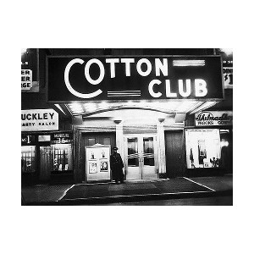
The Jazz Age (#23)
The 1920s were called the Roaring Twenties (because of the booming economy and exploding pop culture lifestyle) and the Jazz Age (because of the popularity of jazz music, which had been taken from the South to the North by African Americans).
Jazz musicians like Louis Armstrong, Duke Ellington, and Benny Goodman were very popular.
Flapper culture revolved around jazz music, as popular flapper dances like the Charleston and the Lindy were done to jazz.
Chicago, New Orleans, and Harlem (with the famous Cotton Club) became jazz meccas.

Slide 19
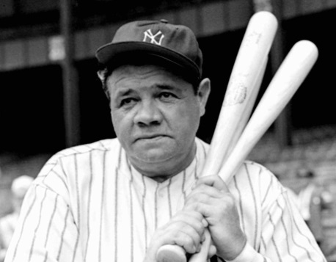
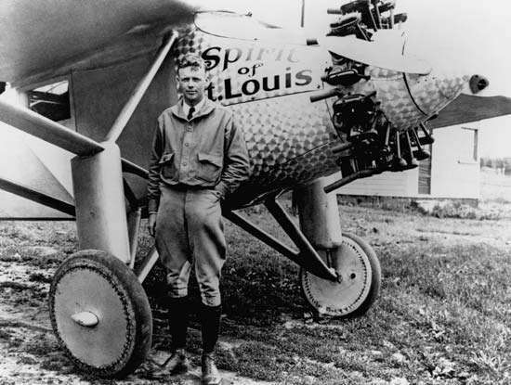
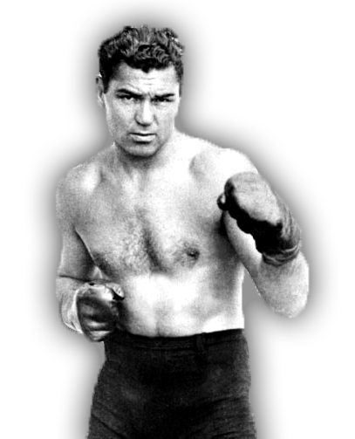
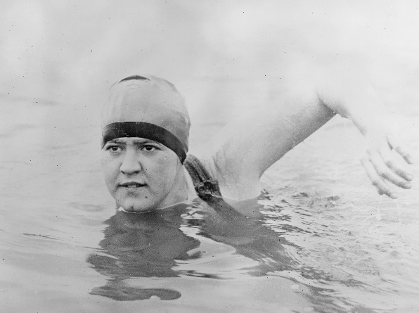
Heroes! (#22)
Heroes like baseball star Babe Ruth, pilot Charles Lindbergh (“Lucky Lindy”), heavyweight boxing champ Jack Dempsey, and Gertrude Ederle (first woman to swim the English Channel) were especially popular in the 1920s because they reminded people of “the good old days” with virtues like hard work leading to greatness.

Slide 20
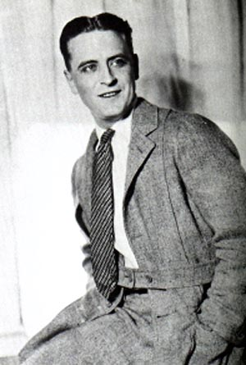
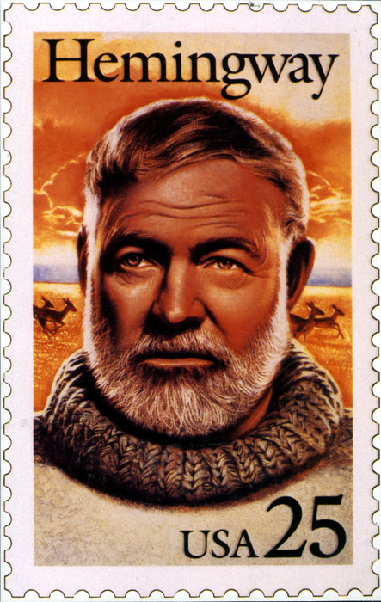
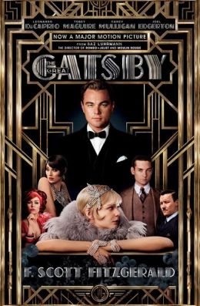
The Lost Generation (#30)
The Lost Generation was a name used to describe a group of American writers who rejected pop culture and materialism, like Ernest Hemingway and F. Scott Fitzgerald.
Many of the Lost Generation moved to Paris.

Slide 21
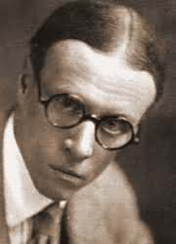
Sinclair Lewis (#29)
Sinclair Lewis was an author whose books were often critical of American people in the 1920s for their focus on capitalism and materialism.
Lewis was especially critical of small-town Americans, and dishonest ministers and doctors.
His best-known novels included Elmer Gantry, Babbit, Main Street, and Arrowsmith.

Slide 22
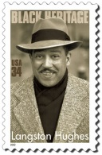
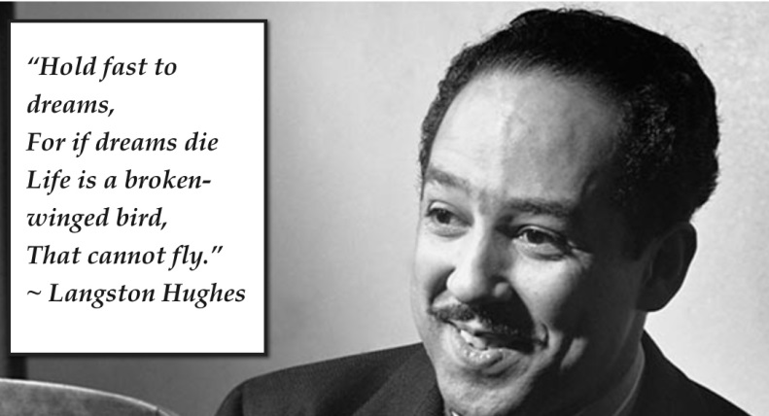
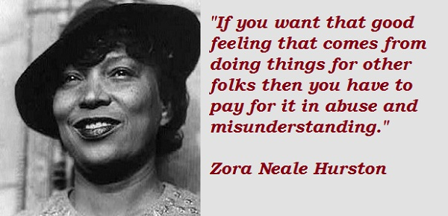
The Harlem Renaissance (#28)
The Harlem Renaissance was an African American literary awakening in the 1920s.
It produced famous black authors & poets, like Langston Hughes and Zora Neale Hurston.

Slide 23
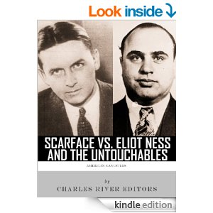
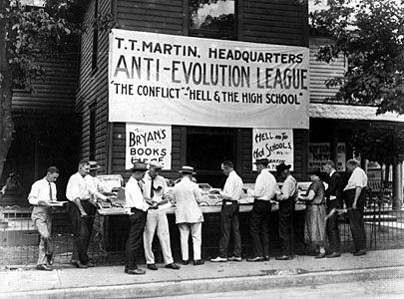
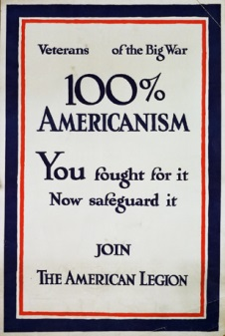
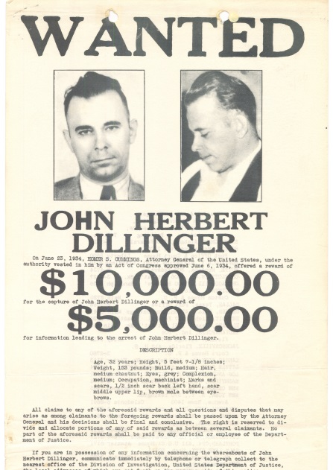
Cultural Conflicts
The 1920s were also known for a series of cultural conflicts in the U.S.
These conflicts occurred over prohibition of alcohol, organized crime, religion, and racial tension.

Slide 24
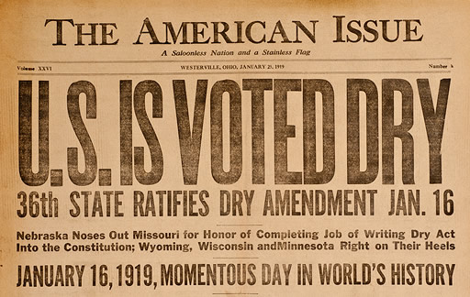
Prohibition
18th Amendment banned manufacture, sale, & distribution of liquor; law passed to enforce this was the Volstead Act.
Goal was to solve societal problems caused by alcohol on the logic that “if alcohol is illegal, no one will drink” – so alcohol-related problems would disappear.
Total alcohol consumption did go down – in some places, to almost zero – but many people continued to drink illegally.
Even President Harding served liquor in the White House at this time.

Slide 25
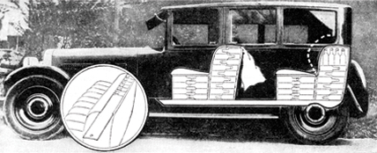
Bootleggers
Bootleggers were suppliers of illegal booze – some had stills, some smuggled alcohol into the U.S.

Slide 26
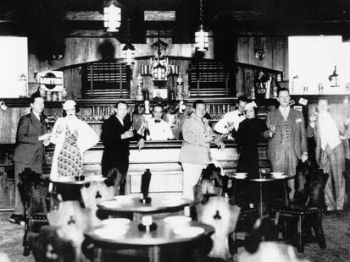
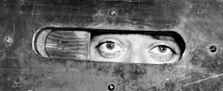
Speakeasies
Speakeasies were illegal bars that operated in secret.
Were often well-known (even listed in city directories as “cigar clubs”), but police sometimes looked the other way and didn’t crack down on them.

Slide 27
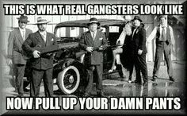
Organized Crime – How it grew (#35)
Supplying illegal liquor on a large scale was complex: it had to be manufactured, transported, stored, and sold.
But there was a huge potential for profit.
Organized crime grew to carry out the task of large-scale bootlegging.
Gangs had “wars” for territory and expanded into gambling, prostitution, & racketeering (in addition to bootlegging).

Slide 28
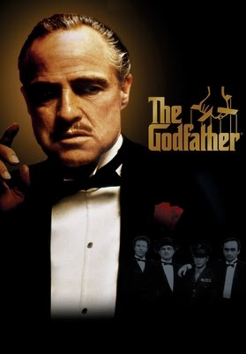
In defense of organized crime?
Although the Mafia is rightly condemned for its illegal and often brutal activities, some have defended it as also having a positive side by protecting people who are “let down” by the legal system.
The opening scene of The Godfather exemplifies this argument.

Slide 29
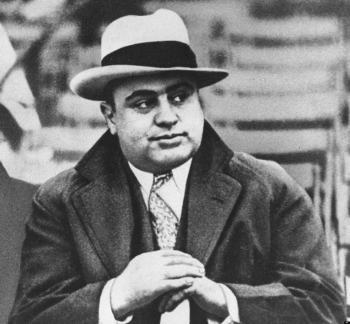
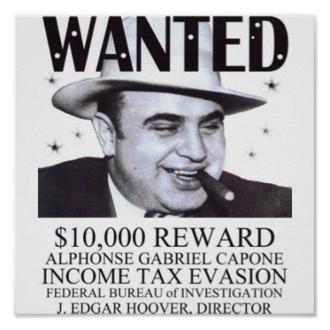
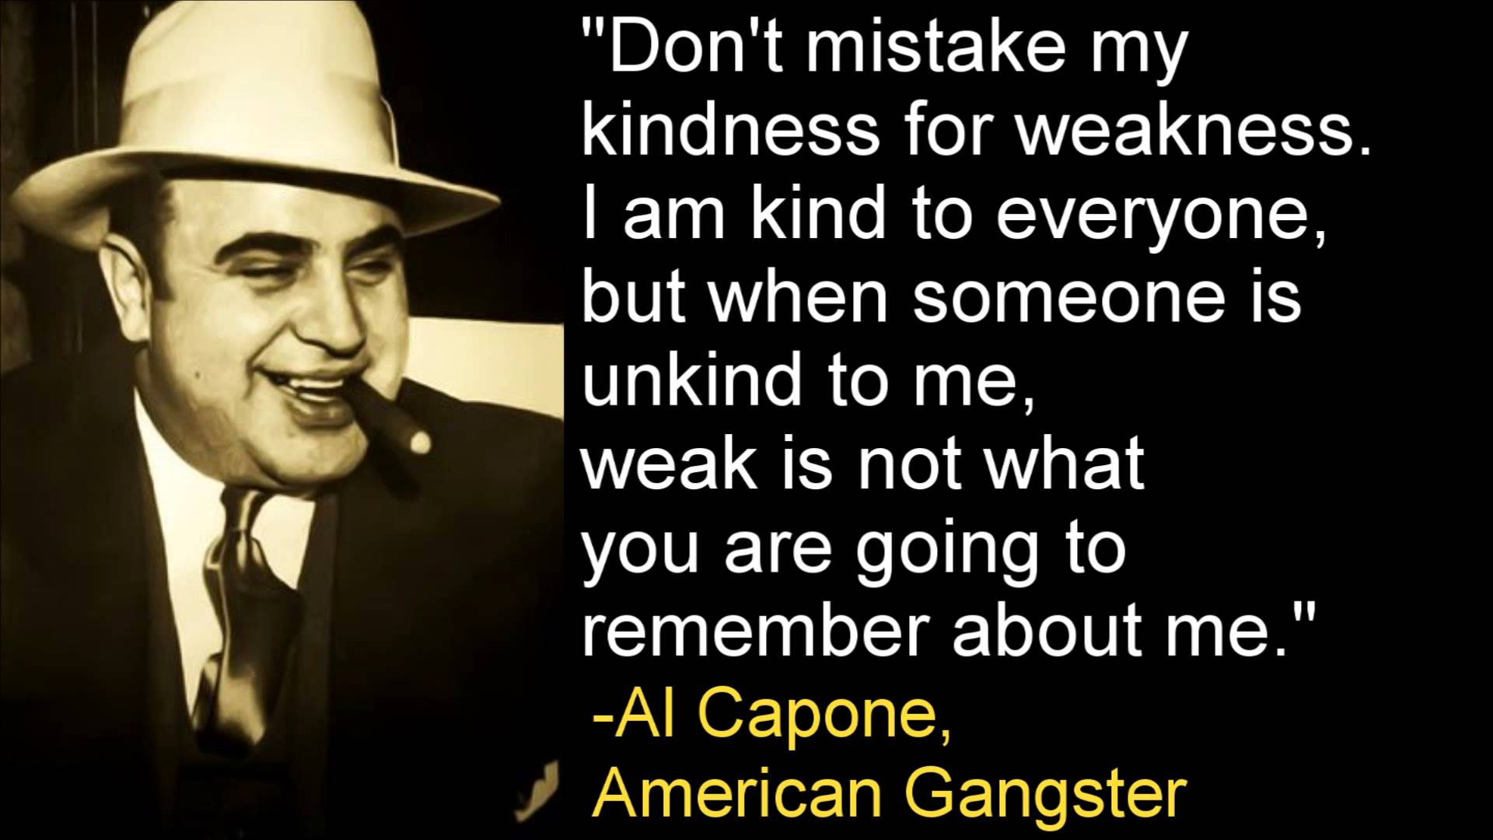
Al Capone
Al Capone was the most well-known and dominant gangster.
Based in Chicago, he avoided prison until 1931 – when he was convicted of federal tax evasion!

Slide 30
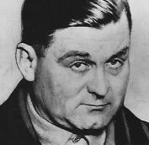
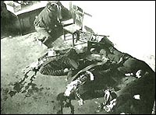
The St. Valentine’s Day Massacre
Capone’s Italian gang from the South Side of Chicago was rivaled by George “Bugs” Moran’s Irish gang on the city’s North Side.
Moran and Capone hated each other.
February 14, 1929: five of Moran’s gang were killed by Capone men (two non-gang members were also killed).
Two of Capone’s men were disguised as uniformed police officers – they “arrested” Moran’s men at a garage owned by Moran, then led them out back and machine-gunned them all.
Moran avoided the massacre – he’d seen the “police” car and stayed away to avoid arrest.

Slide 31
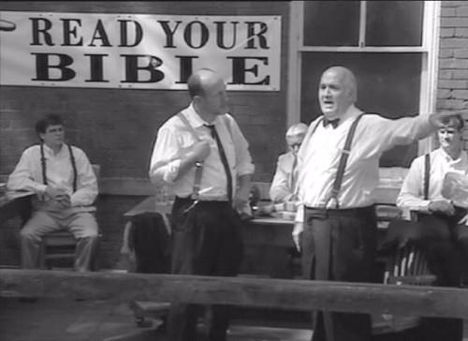
Conflict and Religion (#31)
Fundamentalists: fundamentalist Christians believed that everything in the Bible was literally true because the Bible was inspired by God.
This movement had grown in response to those who questioned religion.
Fundamentalists were especially disturbed and angered by evolutionary theory’s assertion that humans must have evolved from ape ancestors.

Slide 32
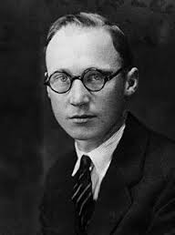
The Scopes Monkey Trial (#32-33)
Fundamentalists in the Tennessee state legislature had passed a law forbidding the teaching of evolution in Tennessee because it appeared to contradict the Bible.
John Scopes, a teacher in Dayton, Tennessee, taught a lesson in evolution – intentionally violating the law.
July 10-21, 1925: the Scopes trial brought national media to Dayton for “the trial of the century.”
This was the first trial ever broadcast on radio.
Famous lawyers: Clarence Darrow defended Scopes; William Jennings Bryan was an expert Bible witness for the prosecution.

Slide 33
Scopes is found guilty, but fundamentalists still lose (#33)
Darrow put Bryan on the stand and embarrassed him by getting him to admit that even he didn’t really believe that every single thing in the Bible happened exactly the way it said (ex. – that Eve was created from Adam’s rib).
Scopes was found guilty & fined $100 – no surprise, because he admitted breaking the law. Verdict was later overturned on a technicality.
Bryan died 5 days after the trial – many think stress from the trial caused this.
Fundamentalism was set back as most Americans saw Scopes and evolution as the real winners in the court of public opinion.
Notes:
Inherit the Wind is a fictionalized version of the case – it changes Clarence Darrow to “Henry Drummond” and William Jennings Bryan to “Matthew Harrison Brady.” John Scopes becomes “Bertram Cates.” The movie used the Scopes trial as a means of criticizing Joe McCarthy/McCarthyism. In the movie, lots of things are much different than in real life – the William Jennings Bryan character dies in the courtroom at the end, the townspeople are hostile and threatening, the Scopes character is arrested in his classroom while teaching a lesson, the Scopes character has a fiancée who is the daughter of the town’s anti-evolution minister, the Scopes character turned away from Christianity because the minister said a little boy who drowned was going to hell because he hadn’t been baptized, etc. – NONE of these things happened in real life and key characters in the movie are just made-up, fictional characters who never existed.

Slide 34
Racial Tension: The Red Summer of 1919 (#25)
Great Migration of blacks into mostly white northern cities led to racial tension, especially when black men competed for jobs against white men (including whites returning from WWI).
Growth of black neighborhoods and enrollment of black students in schools also added tension.
Overcrowding and a heat wave that summer led to race riots in many cities (about 25) – Chicago was the worst.

Slide 35
The Chicago Race Riot of 1919 (#25)
Chicago riot began after a black teenager, swimming in a “white” beach area of Lake Michigan, was hit by a rock thrown by a white man.
The boy drowned after being hit.
Blacks rioted in response; whites rioted in response to that.
Over the next several days, 23 blacks and 15 whites were killed in Chicago, another 537 were wounded, and hundreds were left homeless.
Most Americans demanded an end to rioting and a return to law and order.

Slide 36
The Chicago Black Sox Scandal
1919: angry at their cheapskate owner (Charles Komiskey), the Chicago White Sox lost the World Series on purpose in return for bribes from gamblers.
When the story went public, 8 White Sox players were banned from baseball for life, including the great Shoeless Joe Jackson.
Two of the banned players (Swede Risberg & Happy Felsch) came to Montana and played for Scobey, Montana’s local team (the Scobey Outlaws) in the 1920s for $600/month + expenses.

Slide 37
Racial Tension: Revival of the Ku Klux Klan (#26)
The new Ku Klux Klan used modern publicity & fundraising methods – billed itself as a mainstream group to promote “100% Americanism” and protect American values, women, & children.
Grew because of tension over job competition and fear of immigrants & anarchy.
Many politicians were members or open supporters of the KKK.
Planned Parenthood founder Margaret Sanger spoke to the KKK’s ladies auxiliary in New Jersey.
Even Montana had an active KKK chapter in the 1920s.
The KKK targeted not only blacks, but also Jews, Catholics, and immigrants (in Montana, Catholics were their main target).
Notes:
Joram P. asked “why did the KKK burn crosses?” I found out: the post-Civil War KKK did NOT burn crosses; that didn’t start until after 1905. Burning of crosses actually dated back hundreds of years earlier – most relevant to the KKK, in old Scotland, a clan would burn a cross as a signal for all clansmen to come together to fight/defend the clan in battle. The Klan said it wasn’t sacrilege to burn the cross, because they were actually “lighting” it in a display of faith.

Slide 38
Decline of the KKK (#26)
By 1924, the KKK had 4 million members across the U.S.
But it lost popularity after the head of the Indiana KKK was sentenced to life in prison for raping a teenaged girl (who later poisoned herself).
Also, by the end of the 1920s, the Great Depression began, and many KKK members could no longer afford to pay membership dues; and some just chose other recreational activities for their free time, like going to movies, etc.

Slide 39
Racial Tension: Marcus Garvey (#27)
Marcus Garvey was an activist who promoted black-owned businesses, racial pride, and black nationalism.
He was criticized for calling for race separation – didn’t want blacks associating with whites, was pro-segregation (even met with the KKK), and urged blacks to go “back to Africa” instead of staying in the mostly-white U.S.
Garvey was eventually deported back to Jamaica (his home country) because of mail fraud in stock sales.
Notes:
Marcus Garvey and W.E.B. DuBois hated each other: DuBois said Garvey was “either a lunatic or a traitor” because of his belief in race separation; Garvey despised DuBois as a mixed-race “white man’s nigger.” Garvey met with the KKK in Atlanta in 1922 and gave speeches thanking whites for Jim Crow laws.

Slide 40
The NAACP
The NAACP (National Association for the Advancement of Colored Peoples) was founded in 1909.
In the 1920s (and afterward), the NAACP worked to end lynchings and protect African American voting rights.
A top leader of the NAACP was W.E.B. DuBois (left); he debated fellow African American leader Booker T. Washington (right) over issues like socialism vs. capitalism (DuBois was a socialist, Washington a capitalist) and whether blacks should forgive past racism and move on (Washington’s view) or use examples of past & present racism to agitate and demand government action on behalf of blacks (DuBois’s view).
DuBois was also a eugenicist & believed there was a “talented tenth” – 10% of blacks who were most gifted – who should be encouraged to reproduce, whereas other blacks should have fewer children.
Notes:
DuBois and Planned Parenthood founder Margaret Sanger worked together on the controversial “Negro Project,” which was aimed at decreasing the number of babies born to poor black parents.

Slide 41
The Post-WWI Red Scare (#13)
A Red Scare is a time marked by intense fear of communism – the U.S. has had two Red Scares: one soon after World War I, the other in the early years of the Cold War after WWII.
Vladimir Lenin’s Bolsheviks had turned Russia into the communist Soviet Union (USSR).
A stated goal of the USSR’s Comintern (Communist International) was to spread communism worldwide (including to the U.S.A.).
The Russian Revolution had Americans fearing that the communist takeover could spread to the U.S.A.

Slide 42
Schenck v. U.S., 1919 (#14)
Charles Schenck, secretary of the Socialist Party, was charged with printing leaflets for opposition to the draft during WWI.
The court ruled that the First Amendment freedoms of speech and press did not protect Schenck’s activity, because during wartime such interference with the draft created a “clear and present danger” to the U.S.
Since this case, the courts use the “clear and present danger” rule to decide whether speech is protected or not.
This case also produced the “shouting fire in a crowded theater” analogy.

Slide 43
Gitlow v. New York
Benjamin Gitlow was convicted of criminal anarchy (a state crime in New York) for publishing the “Left Wing Manifesto,” which called for overthrow of the U.S. government.
Important thing about this case was that the U.S. Supreme Court ruled that the 14th Amendment protects citizens from civil rights violations by state governments, too – not just those by the federal government.
However, Gitlow’s civil rights to free speech and free press had not been violated when NY arrested him for his manifesto (because he was creating a clear & present danger) – so he was returned to prison.
Gitlow later became a founding member of the Communist Party USA, but by the late 1930s he turned conservative and became an anti-communist. Interesting guy!

Slide 44
Mad Bombers! (#13)
A series of bombs sent through the mail in the U.S. during 1919 were linked to communists and anarchists, heightening the Red Scare.
One bomb exploded at the house of U.S. Attorney General A. Mitchell Palmer (Palmer wasn’t harmed, but a housekeeper was badly wounded).
The bombs had been sent by followers of anarchist Luigi Galleani.

Slide 45
The Palmer Raids (#17)
After Palmer’s House was bombed, the Justice Department arrested large numbers of suspected radicals who might be connected to the bombings.
These raids were conducted in November 1919 and January 1920.
Around 4,000 immigrants were arrested, and over 500 were deported (they were a “clear and present danger”).

Slide 46
The National Origins Act (again - #15)
The National Origins Act passed in 1924 to limit the number of immigrants to the U.S.
Further restricted southern & eastern Europeans from immigrating to the U.S.; prohibited East Asians and Asian Indians.
This law was aimed at keeping out radicals (communists, anarchists, etc.) and limiting the number of Jews & other “inferior” races who could move to the U.S., based on eugenicist Madison Grant’s data on the superiority of northern Europeans and was widely supported – even labor union leader Samuel Gompers (a Jew himself) was for it.

Slide 47
Impact of decreased immigration on the American work force (#16)
Lower-paying jobs now went mainly to immigrants from Canada and Mexico (instead of those from Europe and Asia).

Slide 48
Sacco and Vanzetti (#18)
Nicola Sacco (top right) and Bartolomeo Vanzetti (top left) were Italian immigrants and anarchists executed for robbery and murder in 1927.
Many claimed that they were not really guilty, but were framed because they were radicals and immigrants at a time when the U.S. was deeply afraid of radicals and immigrants.
Their case deeply divided Americans for decades.

Slide 49
Post-WWI Labor Strikes
Labor strikes were often linked to communism (communists secretly infiltrated labor unions and encouraged regular union members to strike because that would hurt the U.S. economy).
Union membership reached 5 million in 1920, and many strikes were held in demands for higher wages.
However, the economic boom of the 1920s caused a drop in the number of union members and strikes (because why go on strike – or even pay dues to belong to a union – if your job already pays you well?).

Slide 50
The 1920s: A Republican Decade
Republicans held the White House and controlled Congress from 1921 to 1933.
They generally favored business and social stability.
Republican presidents in the 1920s: Warren G. Harding (elected 1920, served 1921-23 and not to be confused with “Warren G” ☺), Calvin Coolidge (served 1923-1929), Herbert Hoover (served 1929-33).
Harding & Coolidge cut taxes by 2/3 and cut the federal budget in half; unemployment dropped from 12% in 1921 to 2% in 1923.
Top income tax rate dropped from 73% to 25%.
Economy boomed until late 1929.
Notes:
Although many forget Calvin Coolidge or dismiss him as a president who “didn’t do anything,” some (including many libertarians) consider him the best president ever – because he cut taxes, his administration did little to infringe on personal freedom, he kept the U.S. out of war, and the economy boomed while he was president.

Slide 51
1920s Business Boom
U.S. has a consumer economy: the economy depends on a large amount of spending by consumers.
More consumer spending = more profits for businesses = higher wages for their employees = even more consumer spending.
Buying on credit became common in the 1920s (before, it was embarrassing to owe money); now, installment plans encouraged people to buy things they couldn’t afford to pay for in cash.
This led to many Americans being in credit debt.
Also, advertisements often now spoke less about a product and more about how it would help the customer’s image.

Slide 52
Business Boom: New Products
The demand for electric power multiplied as use of electric lights & appliances increased in the 1920s.
The U.S. GNP (Gross National Product) grew fast due to better productivity, which was caused by new technology, resources, and management techniques.

Slide 53
Henry Ford and the Model T
The Model T was Ford’s first car.
Built on an assembly line; each worker did one specialized task – goal was to produce more cars & sell them at affordable prices.
15 million Model T’s were built from 1908 to 1927, eventually selling for less than $500 for a brand-new one.

Slide 54
Industrial Growth
Biggest industry in 1920s was auto-making; other new businesses were created to serve car travel & trucking (motels, truck stops, etc.).
P.S. – Notice anything weird about that gas station?
Aviation-related industries also boomed.
Laissez-faire policies: government regulation of business was limited, businesses grew rapidly, monopolies were weakened by competition.
Notes:
That’s not a Nazi gas station! Swastikas were commonly used by American Indian tribes before WWII.

Slide 55
A River Runs Through It
Norman Maclean’s classic story about his family and Montana in his youth was a best-selling book turned into a hit movie.
The film provides a good depiction of 1920s culture in Montana and America.
How much of it is true?

Slide 56
A River Runs Through It: Fact and Fiction
Most of the movie is true, but there are a few deviations from real life:
Norman & Paul Maclean were born in Iowa, but moved to Missoula in 1909, when Norman was about 7.
Top right: Norman’s father, the Reverend Doctor J.H. Maclean. The “Missoula” “Presbyterian” church he preaches at in the movie is really the Redeemer Lutheran Church in Livingston.
Below right: Norman Maclean as a young professor at the University of Chicago.
Although the movie was filmed in Montana, the “Blackfoot River” scenes around “Missoula” were really filmed on the Gallatin, Boulder, and Yellowstone Rivers near Bozeman & Livingston.
The “big stud poker game at Lolo” that Paul got into trouble over was actually a big stud poker game at Montana City. While Lolo is a small town near Missoula, Montana City is a small town near Helena, which is where Paul lived at the time.
Paul also worked for the Great Falls Tribune at one time.

Slide 57
A River Runs Through It: Fact and Fiction
Most of the movie is set in 1926 and most of its events really did happen at that time.
Top right: an elderly Norman Maclean, with his famous quote about the world being full of bastards, the number increasing as you get further from Missoula.
Below right: the real Paul Maclean (played by Brad Pitt in the movie).
The way that Paul Maclean died is accurately portrayed – he was beaten to death, probably over gambling debts.
However, Paul did not die before Norman & Jessie left for Chicago in 1926; he actually lived another 12 years before being killed in 1938.
Also, despite Paul’s promise in the movie that “I’ll never leave Montana,” he did leave – he was living in Chicago and working for the University of Chicago press bureau when he died.
Although he was probably killed over gambling debts, he may also have been killed by gangsters over his reporting on organized crime.

Slide 58
Bypassed by the Boom (#34)
Not everyone did so well in the Roaring Twenties:
Wages & working conditions for unskilled workers didn’t improve.
Farm prices dropped (after having been very high during WWI) – farmers who’d gone into debt to buy more land during the good years and now couldn’t pay back their loans had to either quit and lose their farm, or go deeper into debt to keep operating.

