Slide 1
U.S. History Expansion & Pre-Civil War

Slide 2
Moving Westward: Texas
Tejas (Spanish for “Texas”) was a northern province of Mexico – Mexico had won its independence from Spain in 1821.
Because Tejas was sparsely populated and bordered the U.S., the Mexican government decided to invite Americans to settle in Tejas and become loyal Mexican citizens – idea was that this would boost Tejas’s population and ensure that it remained part of Mexico.
Problem: Americans would swear loyalty to Mexico to get land, but once they moved to Tejas, they really wanted it to become part of the U.S.

Slide 3
A map of Texas when it was still “Tejas” – a province of Mexico

Slide 4
“Tejas” is also a popular early album by ZZ Top! ☺

Slide 5
Texas
Besides whites from the U.S., many Tejanos lived in Tejas (Tejanos were of Mexican blood, but born and raised in Tejas and saw themselves as different from other Mexicans).
Both whites and Tejanos in Tejas resented control from the far-away Mexican capital (Mexico City).
Most troublesome Texas colony of immigrants from U.S. was started by Stephen F. Austin in 1821 – this group soon began demanding that Texas declare independence from Mexico.
By 1830, about 8,000 Americans lived in Texas; by 1835, it was 35,000 Americans (only about 3,500 Tejanos).
Mexico also opened New Mexico to American settlers in 1821, but had much smaller population – mostly fur traders/mountain men.

Slide 6
Stephen F. Austin Founder of a colony of American immigrants to Texas; Austin, Texas (the state capital) and Stephen F. Austin University are named for him.

Slide 7
Mountain Men
Mountain men made their living off the fur trade.
Mountain man era was short – peak years were from about 1825 to 1840.
Beaver pelts were in high demand for hats – after 1835 or so, two things doomed the mountain man era:
#1: Beaver became trapped out in most areas.
#2: Beaver hats went out of style – silk hats were “in.”
Mountain man era is still remembered as a heroic part of American history – most famous mountain men, like Jim Bridger, Kit Carson, & Jedediah Smith are still famous today.
Many mountain men became wagon train guides, army scouts, buffalo hunters, etc. after fur trade era.

Slide 8
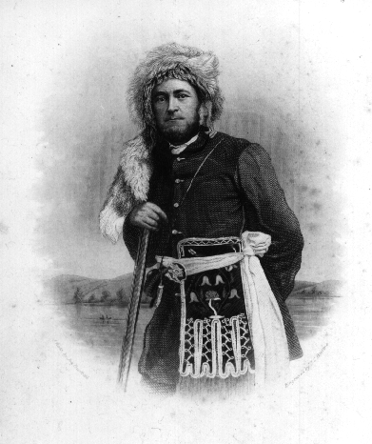
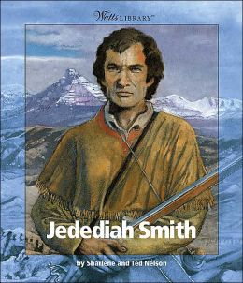
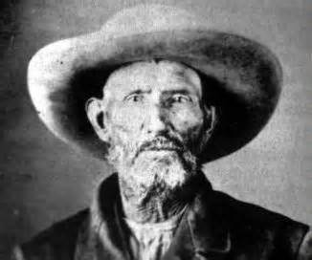
Some of the most famous mountain men: Jedediah Smith, Kit Carson, Joe Meek, Jim Bridger, and Jim Beckwourth. Bridger (bottom right) and Beckwourth (bottom left), in particular, spent a lot of time in Montana – Beckwourth married into the Crow Indian tribe, and Bridger has a town, a creek, and a whole mountain range in Montana named for him!

Slide 9
Oregon
Oregon originally included present-day Oregon, Washington, Idaho, British Columbia, and western Montana.
Several countries claimed Oregon for their own – Britain, Russia, and the U.S.
Oregon Trail was established by Andrew Wyeth in 1832; first used mainly as a route for American missionaries to reach Oregon and bring Christianity to the natives.

Slide 10
More About Oregon
Methodist missionaries led by Jason Lee came to Oregon in 1834; Presbyterian missionaries Marcus Whitman and Henry Spaulding came in 1836, and Catholic missionary Father Pierre-Jean de Smet came in 1844.
Whitman was unsuccessful in converting Cayuse Indians to Presbyterianism – he and his wife Narcissa were later killed by Cayuse warriors after an outbreak of disease killed much of the tribe and a rumor started that Marcus (who was treating the sick) was secretly spreading the disease.
Only 1,000 American settlers lived in Oregon by 1843, but 1,0o0 more came that year, and the number grew quickly afterward.

Slide 11
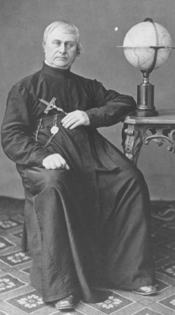
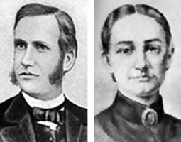
Missionaries to Oregon: Jason Lee; Marcus and Narcissa Whitman; Father Pierre-Jean De Smet

Slide 12
California
Like Texas & New Mexico, California had belonged to Spain, but became part of Mexico in 1821.
Few Mexicans lived in California, and most who did were Californios – of Mexican blood, but born & raised in California and considered themselves different from other Mexicans.
Americans began moving to California (mostly for trade) – by the 1830s, more Americans than Mexicans lived in California.
Cultural differences and sheer distance from Mexico City led Californians, like Texans, to desire independence from Mexico as time went on.

Slide 13
War for Texan Independence, 1835-36
By mid-1830s, uncontrolled immigration of Americans into Tejas was a huge problem for the Mexican gov’t.
General Antonio Lopez de Santa Anna was elected President of Mexico in 1835 – at first, Santa Anna promised more self-government for Texas.
Soon, Santa Anna reversed himself – declared himself dictator of Mexico (“the Napoleon of the West”) and ordered total obedience from Tejas.
Americans and Tejanos revolted against Santa Anna in 1835 and declared Texas an independent republic on March 2, 1836.
Santa Anna marched on Texas with the Mexican army.

Slide 14
Antonio Lopez de Santa Anna President of Mexico during the War for Texan Independence and the Mexican-American War

Slide 15
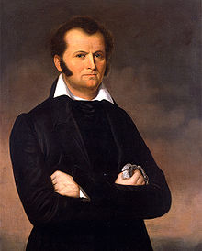
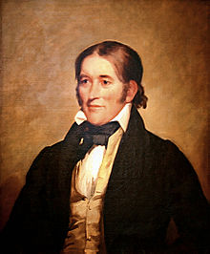
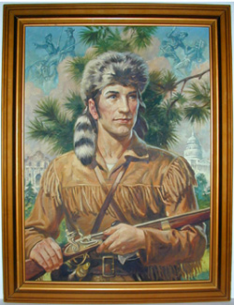
Famous figures at the Alamo: Colonel William Barrett Travis; Jim Bowie; the Bowie knife; the popular image of Davy Crockett; the actual David Crockett. The song “The Ballad of Davy Crockett” became a smash hit in the 1950s: https://www.youtube.com/watch?v=QAVN_n0PljQ

Slide 16
The Alamo
Alamo was an old Spanish mission at San Antonio, Texas – small force of Texans fortified it against Santa Anna.
Texan commanding general Sam Houston decided that the Alamo couldn’t be defended – ordered it to be evacuated & destroyed.
Alamo commander Colonel William Travis refused to leave – 183 men, including the famous Davy Crockett and Jim Bowie, stayed to defend the Alamo.
Santa Anna laid siege for two weeks, then made final attack on March 6, 1836.
All defenders of the Alamo were killed, but over 600 Mexican soldiers died in the assault.

Slide 17
The Alamo, in San Antonio, Texas The Alamo’s fame has lived on in pop culture via films like the 1960 and 2004 versions of “The Alamo,” starring John Wayne and Billy Bob Thornton as Davy Crockett in the respective versions: https://www.youtube.com/watch?v=9LMsjGb1_98 https://www.youtube.com/watch?v=eAoqAWxupSE

Slide 18
“Remember the Alamo!”
As word of their bravery spread, defenders of the Alamo were renowned as heroes, like the 300 Spartans at the ancient battle of Thermopylae.
Soon afterward, Santa Anna captured another fort called Goliad – its 300 Texan defenders surrendered, but Santa Anna declared them all “pirates” and had them executed.
Sam Houston kept retreating, putting distance between his smaller Texan army and Santa Anna until the time was right for battle.
Thousands of Texans fled east to Louisiana to escape massacre by Santa Anna’s force.
Notes:
The 2015 History Channel series, Texas Rising, begins with the aftermath of the Alamo and continues through Sam Houston’s victory over Santa Anna.

Slide 19
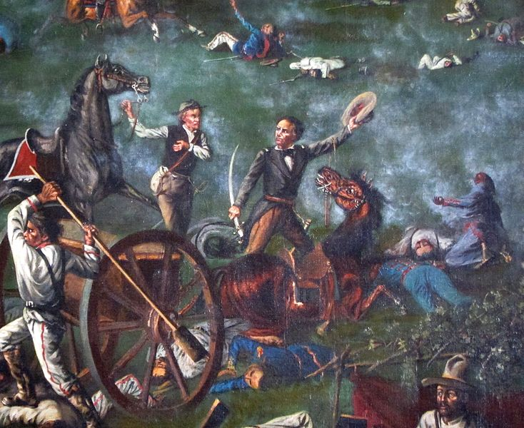
Sam Houston: Leader of the Texan army that defeated Santa Anna; he then became President of the Republic of Texas. Later, he was governor of Texas and a U.S. senator for Texas. Previously, he had been a U.S. representative for Tennessee and then governor of Tennessee. Houston, Texas and Sam Houston State University are named for him.

Slide 20
Don’t Mess With Texas: the Battle of San Jacinto
Near the San Jacinto River in east Texas on April 21, 1836, Santa Anna’s army stopped to rest and take its afternoon siesta.
Nearby, lookouts for Houston’s army reported that the Mexicans were all going to sleep! Houston ordered an immediate attack.
Caught napping, the Mexican army was defeated in less than 15 minutes by the Texans, who shouted “Remember the Alamo! Remember Goliad!”
Santa Anna was taken captive and forced to sign the Treaties of Velasco, which:
#1: Recognized Texas’s independence from Mexico.
#2: Set the Rio Grande River as Texas’s border with Mexico.

Slide 21
The Republic of Texas, 1836-45
Sam Houston was elected as the new President of Texas – a huge supporter of the Union, Houston (and most Texans) wanted Texas to join the U.S.
Northerners in the U.S. didn’t want to add Texas to the Union, because it would become one (or more) slave states and give the slave states a voting advantage in Congress.
President Tyler attempted, but failed, to annex Texas into the U.S. in 1844.

Slide 22
Manifest Destiny
Manifest Destiny: meant that it was America’s destiny to expand across North America, spreading the U.S. system of government and culture from the Atlantic Ocean to the Pacific Ocean.
As the U.S. spread and Americans moved west, “Manifest Destiny” was the popular term that justified it all.
James K. Polk was elected President of the U.S. in 1844; he proposed admitting Texas AND Oregon to the U.S. in 1845 – with Texas entering the U.S. as a slave state and Oregon as a free state, the balance of slave vs. free states in Congress would be kept.

Slide 23
Artists’ conceptions of Manifest Destiny

Slide 24
Adding Texas and Oregon
Polk’s proposal was accepted, and Texas and Oregon joined the Union - this was seen as a big step toward fulfilling our Manifest Destiny.
Question remained: what did “Oregon” really include?
Many Americans said Oregon extended to latitude 54-40 – well into Canada – and demanded war with Britain if needed to stretch the Oregon border so far north, with the slogan “Fifty-four forty or fight!”
In the end, war was avoided as the U.S. and Britain compromised and agreed to accept the current U.S.-Canadian border as the northern boundary of Oregon Territory.

Slide 25
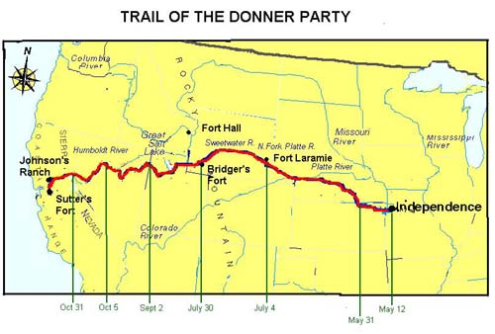
When Manifest Destiny Went Wrong
The tragic story of the Donner Party (8 minutes): https://www.youtube.com/watch?v=DKzkqOZfrsc

Slide 26
The Mexican War, 1846-48
Mexico claimed that Treaties of Velasco were invalid since Santa Anna was forced to sign them while held prisoner by Houston – argued that Texas really still belonged to Mexico.
Finally accepted that Texas was part of U.S. after 1845, but claimed Texas’s border with Mexico was really at Nueces River, not Rio Grande River – which would mean that Texas (and the U.S.) were a little smaller and Mexico was a little bigger.
President Polk offered Mexico $30 million to drop its claim on the disputed area in Texas – Mexico refused.
Polk then sent 2,000 troops to the north side of the Rio Grande.

Slide 27
How to Start a War
Because Mexico considered the area just north of the Rio Grande to be Mexican territory, the U.S. force there was considered an invasion of Mexico – Polk knew this and sent troops there to provoke Mexico.
When Mexico attacked Polk’s force north of the Rio Grande, Polk argued that Mexico had invaded the U.S. and attacked us on our soil – Congress quickly declared war on Mexico, although Whigs (like young congressman Abraham Lincoln) were more opposed to the war – Democrats strongly supported it.
Big reason for lack of Whig support: most Whigs were northerners & saw the war as a southern land-grab to make new slave states from territory taken in war.

Slide 28
The War
The U.S. won most of the battles – General Zachary Taylor defeated the Mexican Army in Texas in May 1846, General Stephen Kearny captured Santa Fe and defeated the Mexican Army in California by early 1847, and General Winfield Scott captured Mexico City (which ended the war) on September 14, 1847.
American settlers in California, led by “mountain man” John C. Fremont, overthrew Mexico, declared California the Republic of California (aka “the Bear Flag Republic”), then immediately petitioned for California to become a U.S. territory.
Fremont, son-in-law of famous senator Thomas Hart Benton, unsuccessfully ran for president in 1856.

Slide 29
A Map of U.S. Troop Movements in the Mexican War

Slide 30
John C. Fremont California pioneer and revolutionary for the Republic of California during the Mexican War; later U.S. senator for California; first presidential candidate for the new Republican Party in 1856

Slide 31
The War Ends, the U.S. Grows
Treaty of Guadalupe-Hidalgo, 1848: officially ended the Mexican-American War – U.S. gained all territory from Texas to the Pacific Ocean (including present-day California, Nevada, Arizona, New Mexico, Utah, & part of Colorado).
P.S. – Gold was discovered in California later that year!
Mexico was paid $15 million in compensation.
Most Americans were thrilled about the new territory (Manifest Destiny), but not all – poet Henry David Thoreau refused to pay taxes to support the war – this landed him in jail, where he wrote “Civil Disobedience,” which encouraged Americans to disobey unjust laws, even if it meant going to jail.

Slide 32
Henry David Thoreau Famous transcendentalist poet and author; protested against the Mexican War and slavery by refusing to pay poll tax – went to jail instead, where he wrote Civil Disobedence.

Slide 33
A map of the Mexican Cession – new territory added to the U.S. by the Treaty of Guadalupe-Hidalgo

Slide 34
The Gadsden Purchase: Completing the Puzzle
Gadsden Purchase, 1853: U.S. paid Mexico $10 million for land in southern Arizona and New Mexico (terrain was ideal for future railroad construction) – this completed the map of the continental U.S. (the lower 48 states) as it is today.
The huge new territories (mainly the Mexican Cession from the Treaty of Guadalupe-Hidalgo) opened much more land for settlement – but also led to more conflict between the North and South about whether the new territories would be slave or free.

Slide 35
A map of the Gadsden Purchase, which completed the continental United States (Alaska and Hawaii were added later)

Slide 36
For the record: Presidents of the 1840s-1850s
William Henry Harrison, Whig, 1841-1841: died of illness one month after taking office.
John Tyler, Whig, 1841-1845: Had been Harrison’s VP.
James K. Polk, Democrat, 1845-1849: Won Mexican War, added Mexican Cession to U.S. Chose not to run again.
Zachary Taylor, Whig, 1849-1850: General & hero of Mexican War, elected in 1848, died of illness in 1850.
Millard Fillmore, Whig, 1850-1853: Had been Taylor’s VP; last Whig president, last president to not be either a Democrat or a Republican.
Franklin Pierce, Democrat, 1853-1857
James Buchanan, Democrat, 1857-1861: Only president to remain a lifelong bachelor.
Out of this bunch, only Polk is considered to have been a success.

Slide 37
Reforming Society
Many individuals and groups tried to reform and improve American society in the 1830s & 1840s:
Protestant Revivalists preached that people could reform themselves, thereby making the U.S. great.
Transcendentalists encouraged self-reliance, reflection, meditation, and acting on one’s beliefs to improve society.
Transcendentalist leaders included writers Henry David Thoreau and Ralph Waldo Emerson. Thoreau did much of his writing at or near his cabin at Walden Pond – in the 1990s, a successful “save Walden Woods” campaign was led by Don Henley of the band, Eagles, after a housing development was proposed to be built on the site.

Slide 38
More Reformers
Temperance movement: opposed use of alcohol, argued that most of society’s problems were caused by drinking (especially by men drinking too much).
Horace Mann: reformer of education – proposed widespread public schools, compulsory education (before this, most schools were private and many children never attended school).
Dorothea Dix: reformed prisons – lobbied for cleaner, more humane facilities, and for mentally ill/impaired to be kept in mental institutions instead of prisons.
Abolitionists: many whites and blacks argued against slavery, but former slave Sojourner Truth was known as both an abolitionist AND a women’s suffrage activist.

Slide 39
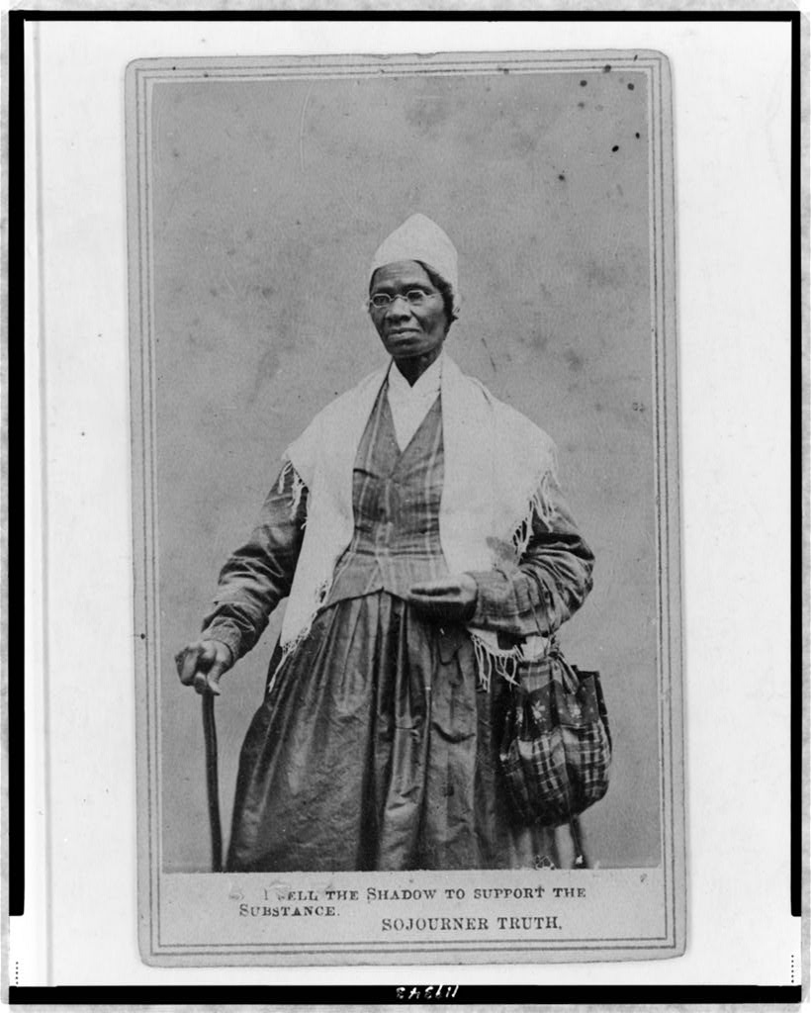
Sojourner Truth
Former slave who became an abolitionist and women’s suffrage activist.

Slide 40
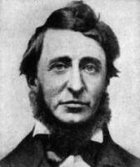
Henry David Thoreau and Walden Pond

Slide 41
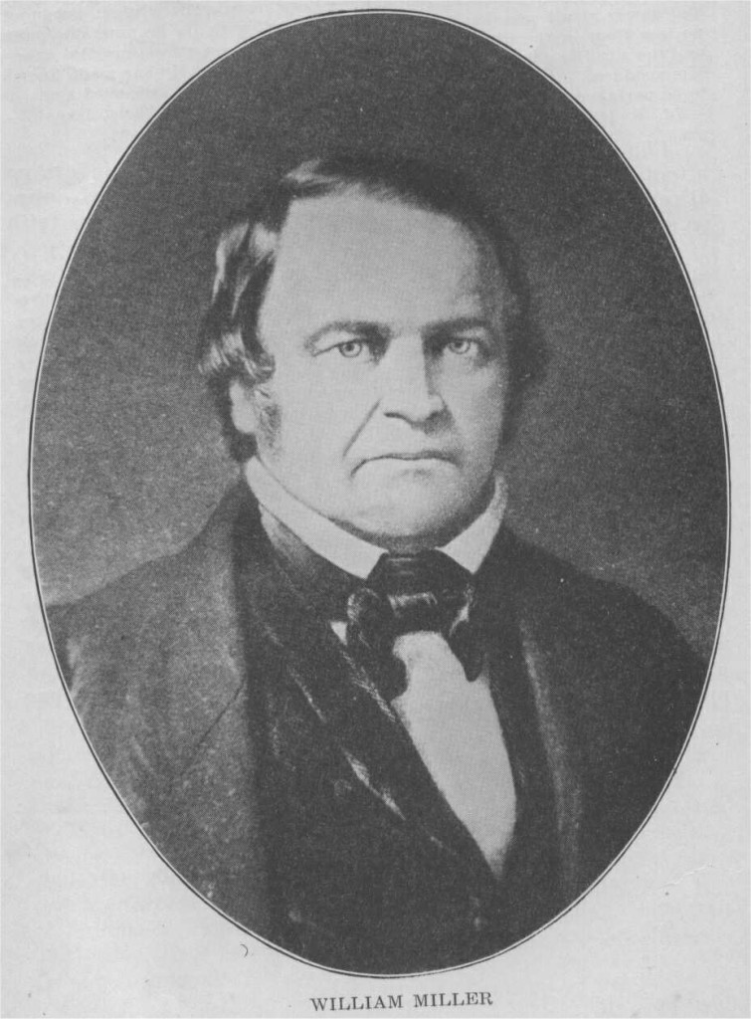
Some Broke Away from Society
Utopian communities separated themselves from the rest of society and lived by religious rules – included Shakers and Millerites.
Millerites: founded by William Miller (right) in 1833.
Predicted that the world would end on October 22, 1844 with the second coming of Christ.
When October 22, 1844 came and went without incident, it was dubbed “the Great Disappointment.”
Most Millerites then either became Shakers or went back to their old religions.

Slide 42
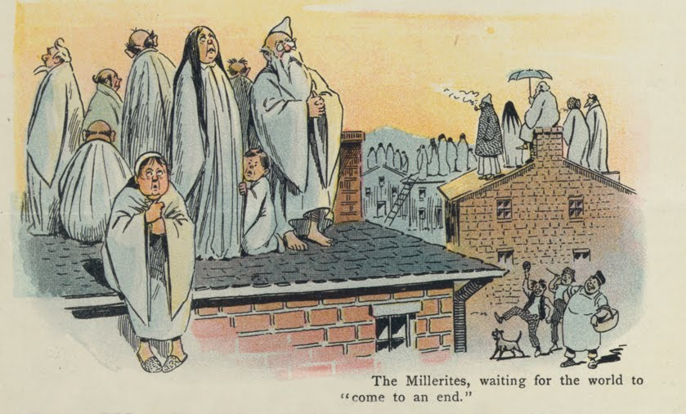
Contemporary news and political cartoon about the Millerites

Slide 43
The Dispute Over Slavery
People would kill over slavery: one example was Elijah Lovejoy, a minister with an antislavery newspaper – he was killed by a proslavery mob in Illinois in 1837.
The Wilmot Proviso: proposed amendment to a bill in Congress in 1846 – would have outlawed slavery in all lands won from Mexico.
The proviso did not pass, but southerners were furious that it had even been proposed.
As slavery threatened to destroy the Union, Henry Clay (“the Great Compromiser”) introduced one last compromise to save the Union – the Compromise of 1850.
The idea of the compromise was that it had some things for the North AND some things for the South – to make both happy.

Slide 44
The Compromise of 1850
1. California was admitted to the U.S. as a free state (something for the North – especially good since the California gold rush was in full swing by then).
2. People in New Mexico and Utah territories would use popular sovereignty (voting) to decide whether to be slave or free.
3. The slave trade was abolished in Washington, D.C. (something for the North), but slavery was still legal there (something for the South).
4. Texas dropped its claim to New Mexico in exchange for $10 million.
5. The Fugitive Slave Act: all citizens must assist in return of escaped slaves from the North to the South (this was a HUGE deal for the South).

Slide 45
Compromise of 1850 Map

Slide 46
Reaction to the Compromise
The Compromise of 1850 did hold the Union together – for a little while longer.
Abolitionists were outraged by the Fugitive Slave Law – now slaves who’d escaped to freedom in the North could still be returned to bondage in the South.
Many northern states passed Personal Liberty Laws that stated that their citizens did NOT have to assist in the return of escaped slaves.

Slide 47
A poster warning about the Fugitive Slave Law

Slide 48
Uncle Tom’s Cabin
Novel by Harriet Beecher Stowe – sold 300,000 copies in first year alone; convinced many northerners that slavery would destroy the Union and slavery must therefore be abolished.
Southerners responded that the book was filled with lies and propaganda.
Years later, Stowe met President Lincoln during the Civil War – he said, “so you’re the little lady who started this big war?”
Harriet’s brother, Henry Ward Beecher, was a famous abolitionist minister – he later sent rifles, nicknamed “Beecher’s Bibles” to antislavery fighters in “Bleeding Kansas.”

Slide 49
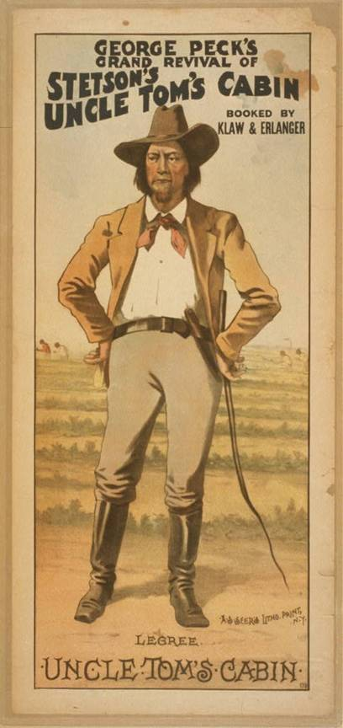
Images of Uncle Tom’s Cabin

Slide 50
The Kansas-Nebraska Act of 1854
Created by Senator Stephen Douglas, Illinois – Kansas and Nebraska became U.S. territories, which would allow a transcontinental railroad to be built through them (after being started in Chicago).
Goals of the act were to both make Chicago a railroad center to the West and help Douglas get elected president.
As for the slavery issue, it would be decided in each territory by popular sovereignty – elections.
Two immediate effects of the act: it negated the Missouri Compromise, which had banned the possibility of slavery in the North, AND it caused both proslavery and antislavery settlers to rush to Kansas so their side could win the vote on slavery.

Slide 51
Bleeding Kansas
Both proslavery and antislavery settlers claimed that their side had won Kansas’s election to decide the slave vs. free issue.
Proslavery forces proclaimed Lecompton the new capital of Kansas; antislavery forces said Lawrence was the real capital – the two towns were only 12 miles apart.
Unable to agree, the two sides soon engaged in a civil war, killing up to 200 in 1856 – massacres on both sides.

Slide 52
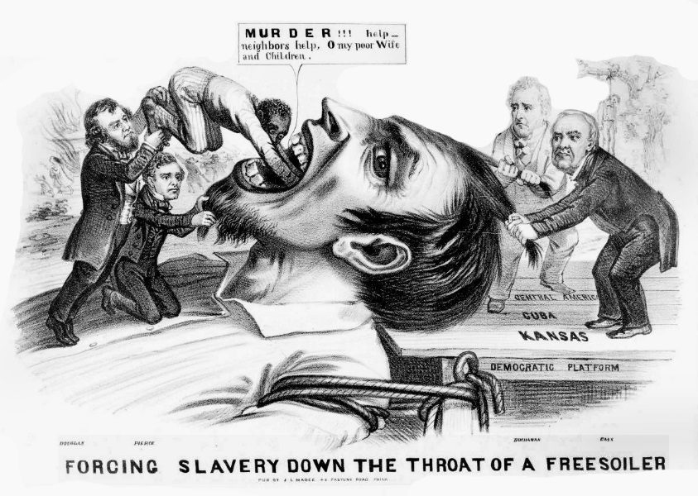
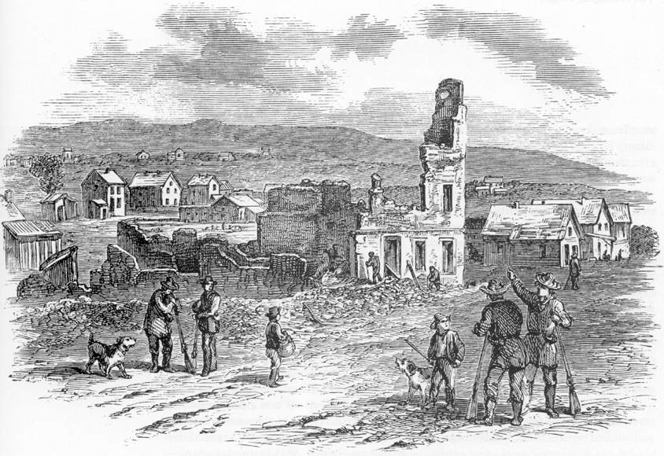
Bleeding Kansas: The photo of the cannon crew is of a group of Freesoilers, including one of John Brown’s sons (far right); the sketch of the burned-out town is a Freesoil town destroyed by proslavery forces

Slide 53
Charles Sumner and Preston Brooks
Antislavery Massachusetts senator Charles Sumner gave a speech in Congress about “the crime against Kansas” in May 1856.
On May 22, 1856, South Carolina representative Preston Brooks approached Sumner at his desk in the Senate and beat him with a cane – until the cane broke!
Sumner was blinded by his own blood – meanwhile, Representative Laurence Keitt used a pistol to hold off other senators who might try to help Sumner.
Sumner became a martyr to abolitionists but didn’t recover enough to return to Congress for three years.
Brooks became a hero to southerners – some sent him new canes with the message, “Hit him again!”

Slide 54
Proslavery representative Preston Brooks beating abolitionist senator Charles Sumner

Slide 55
The Dred Scott Case
Scott (aka Sam Blow) was a slave who’d once been taken by his former owner, Dr. John Emerson, from Missouri to Illinois (a free state).
Scott later sued, claiming that the Missouri Compromise’s ban on slavery in the North meant that he should have been automatically set free when his owner took him to Illinois.
The Supreme Court ruled against Scott (Dred Scott v. Sandford, 1857) – Chief Justice Taney opined that blacks who were slaves or descendants of slaves could not become citizens, hence had no citizens’ rights (like the right to sue).

Slide 56
Dred Scott, a.k.a. Sam Blow

Slide 57
The Dred Scott Case, Part II
The Court also ruled that the Missouri Compromise’s ban on slavery in the North was unconstitutional, and that Congress could not prohibit slavery in federal territories.
Southerners rejoiced over this outcome – northerners were outraged.
It resulted in many northerners joining the Republican Party, which had recently been formed primarily as an anti-slavery party.
The Court’s decision also prompted a demand to change the Constitution to outlaw slavery – and became a major cause of the Civil War.

Slide 58
Whatever happened to Dred Scott?
Scott lost his case, but ultimately became a free man.
On May 26, 1857, Scott and his family were purchased by the sons of Scott’s original owner, Peter Blow.
Blow’s sons immediately freed Scott and his family – but Scott didn’t get to enjoy his freedom for long, as he died of tuberculosis on November 7, 1857.

Slide 59
The Lincoln-Douglas Debates
Little-known Abraham Lincoln challenged powerful Stephen Douglas for one of Illinois’s senate seats in 1858.
Important fact to know: back then, senators were elected only by the state legislature, not by popular vote of all the state’s citizens.
Seven debates in all: one candidate spoke for 60 minutes, the second spoke for 90 minutes, then the first candidate got to speak for another 30 minutes.
Douglas tried to show Lincoln and all Republicans as abolitionist extremists.

Slide 60
Abraham Lincoln and Stephen Douglas

Slide 61
Lincoln-Douglas Debates, Part II
Douglas won the election, but lost southern support for a future presidential bid with his Freeport Doctrine, which argued that citizens of a U.S. territory should be able to outlaw slavery there by popular sovereignty – this went against the Dred Scott ruling that the federal government could not outlaw slavery.
Important to know that Douglas was a Democrat and basically all white southerners at that time were also Democrats – it was the proslavery party.
Lincoln lost the election, but gained national fame for his debating skill, which suddenly made him a p0ssible Republican presidential candidate for 1860.

Slide 62
One of the Lincoln-Douglas debates Note the difference in height – at about 5 foot 4, Douglas was called “the Little Giant;” at 6 foot 4, Lincoln seemed like a giant next to Douglas!

Slide 63
John Brown
Brown was a radically religious abolitionist who believed it was his mission from God to free slaves and punish slaveholders.
In Bleeding Kansas, Brown and his sons (well, some of his sons – Brown had 20 children!) had used swords to hack to death five proslavery men.
In 1859, Brown planned to raid the federal arsenal at Harper’s Ferry, Virginia, then distribute the weapons from the arsenal to slaves in the surrounding area, forming a slave army that would sweep through the South, growing as it freed more slaves, and finally wiping out slavery from the U.S.

Slide 64
John Brown’s Raid
Brown and his followers carried out their raid on Harper’s Ferry on October 16, 1859 – attacking the town and temporarily seizing the arsenal.
A total of seven people were killed; ironically, one of the first people killed by Brown’s men was a free black named Hayward Shepherd.
Brown and his men were soon captured by troops led by U.S. Army officer Robert E. Lee.
Brown was sentenced to death and hanged on December 2, 1859.
One of the attendees at Brown’s hanging was John Wilkes Booth, who later assassinated President Lincoln.

Slide 65
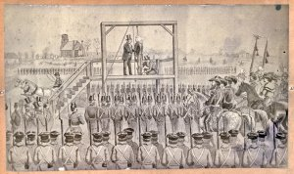
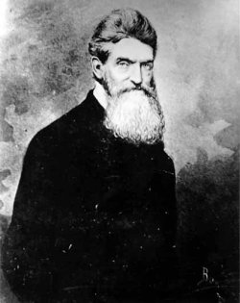
John Brown The picture of Brown with a beard shows him as he looked around the time of his raid on Harper’s Ferry and his subsequent hanging for treason against the State of Virginia

Slide 66
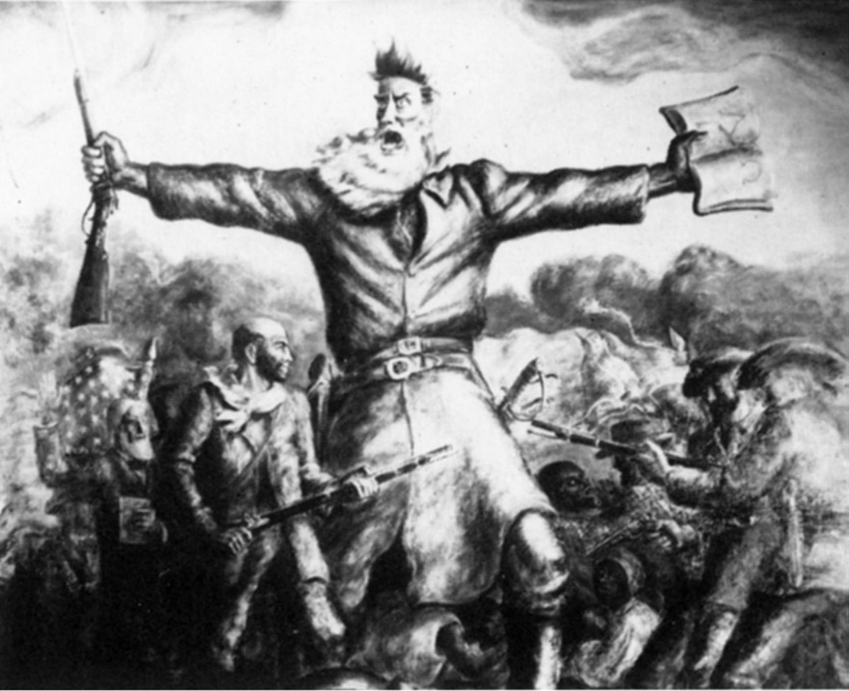
Importance of John Brown
Brown was a villain to the South, and criticized by many in the North, but many also considered him a hero and martyr.
The black abolitionist Frederick Douglass said that Brown’s commitment to abolition greatly surpassed his: “I could only live for the slave. John Brown could die for him.”
Brown is sometimes called “the Meteor” that signaled the start of the Civil War.
The Union army’s “Battle Hymn of the Republic” (“Mine eyes have seen the glory of the coming of the Lord…”) was sung to the melody of “John Brown’s Body” (“his truth is marching on…”).

Slide 67
The Election of 1860
Four-way race for president: Lincoln (whose name wasn’t even on the ballot in 10 southern states!) won with only 39% of the popular vote, but got 180 electoral votes.
Other candidates were Northern Democrat Stephen Douglas, Southern Democrat John Breckinridge, and Constitutional Union candidate John Bell.
After the election Lincoln was burned in effigy in many places in the South – many southerners believed Lincoln was a radical abolitionist and would encourage slave rebellions.

Slide 68
Secession
In protest of Lincoln’s election, seven southern states, starting with South Carolina, seceded by March 1861, declaring themselves the Confederate States of America (aka the Confederacy).
Outgoing president James Buchanan considered secession illegal, but believed he had no legal power to stop it and did nothing – historians now often rank him as the worst president ever.
Not all southerners were for secession: one wrote, “South Carolina is too small for a republic, and too large for an insane asylum.” ☺
After taking office, Lincoln had no plans to use force, but refused to accept secession, saying he’d rather be assassinated than see a single star removed from the American flag.

Slide 69
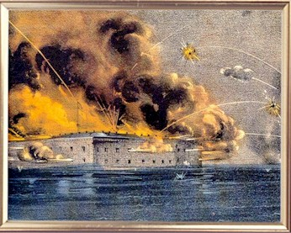
Images of the shelling of Union Fort Sumter by Confederate troops in Charleston, S.C., which started the Civil War

Slide 70
Fort Sumter: The Civil War Begins
Fort Sumter was a Union fort on an island in Charleston Harbor (South Carolina) – it had to be resupplied regularly.
After Lincoln took office, the Confederates waited to see if he would remove Union troops from the fort, or resupply them – if he resupplied them, it would mean that only an act of war could close down the fort.
Lincoln resupplied the fort – the Confederates then made plans to capture it.
The Civil War began as Confederate troops fired on Ft. Sumter April 12, 1861 & captured it the next day.
There were no casualties at Ft. Sumter – but over 620,000 would die in the war.
The Confederate commander, General Pierre Beauregard, was an old West Point classmate of the Union commander, Major Robert Anderson – first of many cases of friend vs. friend, brother vs. brother, which the Civil War became famous for.

