Slide 1
U.S. History: The Civil War and Reconstruction
Dr. Donnelly

Slide 2
North vs. South: A Comparison of Resources
Union (North): 22 million people
Confederacy (South): 9 million people, of whom 4 million were slaves
Union: 22,000 miles of railroad
Confederacy: 9,000 miles of railroads
Union: 110,000 factories
Confederacy: 20,000 factories

Slide 3
North vs. South: Comparison Continued
Union: $1.6 billion in products
Confederacy: $155 million in products
Union: $262 million in finance
Confederacy: $74 million in finance
Union: Grew many types of crops
Confederacy: Depended on a few staple crops – cotton, tobacco, and rice
The Union had a HUGE advantage in resources; basically, the only things that the South had more of than the North were cotton and slaves!

Slide 4
Confederate Weaknesses
Lacked the North’s economic, industrial, and manpower strength.
Believed the North was divided and wouldn’t put up a strong fight.
Expected aid from Britain and France.
Overconfidence – thought Southerners were naturally superior soldiers (“one good Southern soldier is worth 10 Yankee hirelings”).
Didn’t utilize slaves in their war effort.
Border open to attack.
Weak central government.

Slide 5
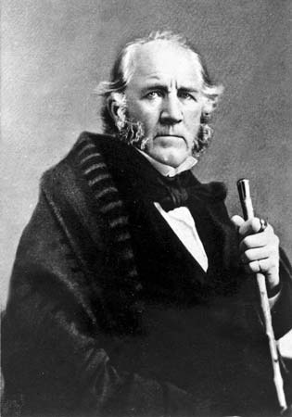
Sam Houston’s Warning
Sam Houston (former president of the Republic of Texas and governor of Texas when it became a U.S. state) warned his fellow Southerners not to go to war against the North because it was far too wealthy, with too large a population and too many material resources, and – most important – a strong will – he believed that the South could never beat the North.
Houston was a firm believer in the Union and wanted the South to stay in it.

Slide 6
Confederate Advantages
The South did have a FEW things in its favor:
Didn’t have to conquer the North to win the war, only prevent the North from conquering them – so the South could fight a defensive war (an attacking army usually suffered more losses than the one taking the defensive).
Fighting on home territory for most of the war – knew the land better.
Better military leadership at beginning of war (North caught up by the war’s end), especially with Generals Robert E. Lee and Thomas “Stonewall” Jackson.

Slide 7
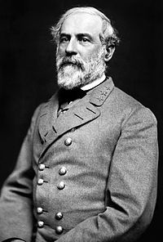
Robert E. Lee
Lee was offered command of the Union Army at the beginning of the war.
The next day, he resigned from the U.S. Army, saying he could not take up his sword against his home state of Virginia (which was in the Confederacy).
The Confederacy then appointed him commanding general of the Army of Northern Virginia.

Slide 8
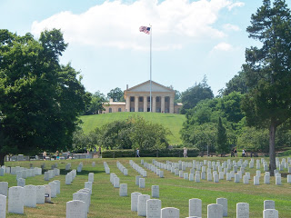
Arlington
Lee lived in this mansion on his estate in Arlington, Virginia.
It is now part of Arlington National Cemetery – why?
Union Quartermaster General Montgomery Meigs’ son was killed in battle against Lee’s army.
Meigs then ordered Lee’s home to be turned into a national cemetery – so Lee could never live there again.

Slide 9
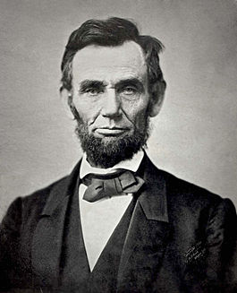
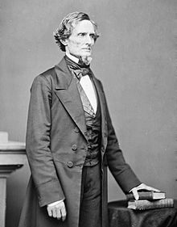
The Presidents and Their Goals
Abraham Lincoln’s main goal in the war, as President of the United States, was to preserve the Union.
Jefferson Davis’s goal, as President of the Confederate States of America, was to force the U.S. to recognize the C.S.A.’s independence.

Slide 10
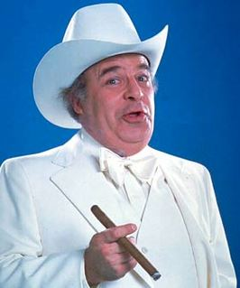
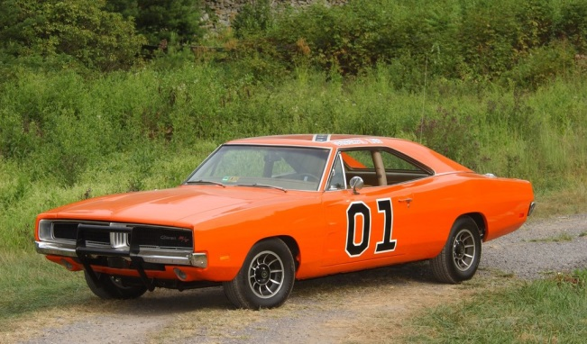
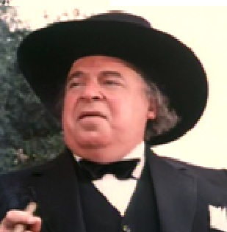
Remembering the Civil War via “The Dukes of Hazzard:” General Robert E. Lee and the General Lee; Confederate President Jefferson Davis and Jefferson Davis Hogg (aka Boss Hogg); Union President Abraham Lincoln and Boss’s cousin, Abraham Lincoln Hogg. ☺

Slide 11
War Strategies
Union strategy, created by General Winfield Scott, was 3-pronged:
Blockade the South with the Union navy
Capture the Mississippi River, cutting the South in half
Capture Richmond, the Confederate capital city
Called the Anaconda Plan because it was supposed to squeeze the South to death the way an anaconda kills its prey.
Confederate strategy was simple: fight off Union invasions of the South and hold out until the North got tired of war and gave up.

Slide 12
Boy, were they wrong: many on both sides predicted a quick end to the war, and few casualties
One member of Congress offered to wipe up all the blood that would be spilled in the war with a single pocket handkerchief.
Many predicted the war would be over by Christmas.
Instead, the war lasted four years, and more Americans died – 620,000 – than in all other American wars combined.

Slide 13
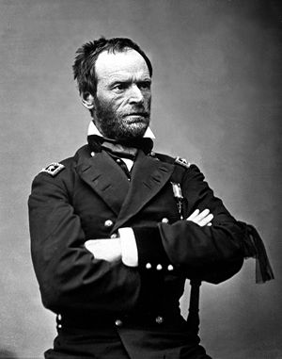
General Sherman’s Prediction
Union general William Tecumseh Sherman wrote to his brother, a congressman from Ohio, and said:
“You politicians have made one hell of a mess… I think this will be a long war, very long… and bloody.”
Many who heard of Sherman’s predictions of a long, bloody war thought he’d lost his nerve – or his mind – and was no longer fit to command; it turned out he was right on.

Slide 14
New Technology in the Civil War
Rifles replaced muskets – could shoot 5 times as far.
Cannons now fired explosive shells and canister shot – much more destructive than solid cannonballs.
The new guns made massed charges into enemy defenses near-suicide, but tactics hadn’t changed yet – caused extremely high casualties.
Also, first use of telescopic sights and land mines.
More soldiers died in hospitals than on battlefields – medical treatment was primitive, with lots of amputations and deaths from infection.
Odds of a soldier dying in battle: 1 in 65; odds of dying of disease: 1 in 13!
Also lots of soldiers became morphine addicts – it was a new “wonder drug” painkiller.

Slide 15
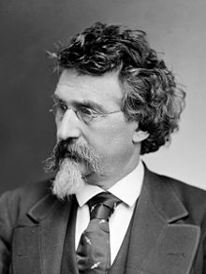
A leg amputation about to be performed at a Civil War field hospital; famous photographer Mathew Brady

Slide 16
More New Technology
Railroad transport of armies – quick troop movements changed outcome of some battles.
Ironclad warships made wooden ships obsolete.
First use of a submarine: the C.S.S. Hunley.
Hot air balloons used to observe positions & movements of enemy troops.
Telegraph lines used for near-instant communication – but could be cut or eavesdropped on.
Photographs showed the war in graphic detail – first war to be widely photographed. Most famous photographer, Mathew Brady, became a celebrity.

Slide 17
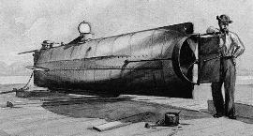
The Story of the CSS Hunley, the world’s first submarine
Hunley held a crew of eight men & was powered by hand cranks turned by the crew.
It sunk during its first test run, with all eight men on board – including its inventor, H.L. Hunley – dying of asphyxiation.
February 17, 1864: the Hunley used a “torpedo” to sink the USS Housatonic in Charleston Harbor, but also sunk itself – once again, all 8 crewmen died of asphyxiation.
Hunley was raised in 2000 & is now on display at Charleston Harbor.

Slide 18
The Civil War’s First Years: 1861-1862
First Battle of Bull Run: July 21, 1861.
Was the first major battle of the war.
Called First Battle of Manassas by the South (South named battles after closest town; North named them after geographic features – “Bull Run” is the name of the creek that ran through the battlefield).
Commanding generals were Irvin McDowell for the Union and P.G.T. Beauregard for the Confederates.
Union expected to win easily, but Confederates rallied around General Thomas “Stonewall” Jackson’s troops and forced Union to retreat.
The loss was humiliating for the Union.

Slide 19
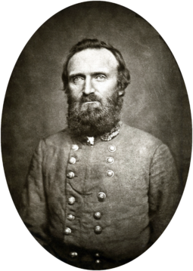
A painting of the Battle of Bull Run; Stonewall Jackson earned his nickname at Bull Run

Slide 20
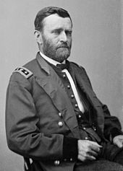
General Ulysses S. Grant – a bright spot in the Union war effort
Out west, the war went better for the Union – thanks to Grant, whose army captured Fort Henry on February 6, 1862 and Ft. Donelson on February 16, 1862 (the two forts were only 12 miles apart).
After Donelson, people said the “U.S.” in Grant’s name really stood for “Unconditional Surrender” because that’s what he demanded from Ft. Donelson.

Slide 21
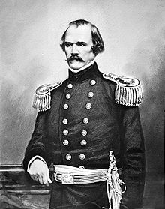
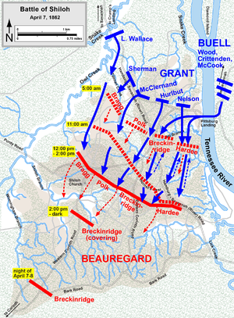
The Battle of Shiloh
At Shiloh, Confederate army led by General Albert Sidney Johnston (photo) attacked Grant’s Union army on April 6, 1862 and nearly defeated Grant – but darkness forced the battle to end for the day.
Grant counterattacked on April 7 and drove the Confederates back. General Johnston was lost to the South, as he bled to death from a leg wound suffered in the battle.
Bloodiest battle so far in the war – Union lost 13,000 men, Confederates lost 11,000.
Soldiers would later describe an especially bad battle by saying “I was worse scared than at Shiloh.”
After Shiloh, President Lincoln valued Grant’s fighting spirit more than ever.

Slide 22
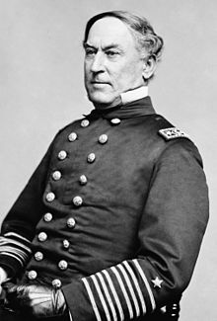
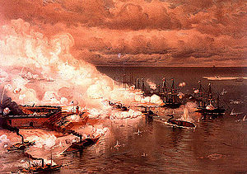
Union Capture of New Orleans
Admiral David Farragut (right) captured New Orleans, April 29, 1862 and took control of the mouth of the Mississippi River – this helped the Union begin achieving its goal of capturing the Mississippi to divide the South.
Farragut later won fame for saying “Damn the torpedoes, full speed ahead!” during the Battle of Mobile Bay (right), which he won in 1864.

Slide 23
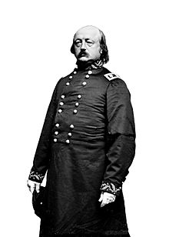
General Benjamin Butler
After Farragut captured New Orleans, the Union army occupied the city under the command of General Benjamin Butler.
New Orleans women began protesting against Union troops by emptying chamber pots onto their heads from upper floor windows as they walked through the streets of the French Quarter. GROSS!
When this happened to Farragut himself, Butler announced that any New Orleans woman who insulted Union troops would be deemed a prostitute and arrested.
Southerners nicknamed Butler “The Beast” and began making chamber pots with his likeness inside.

Slide 24
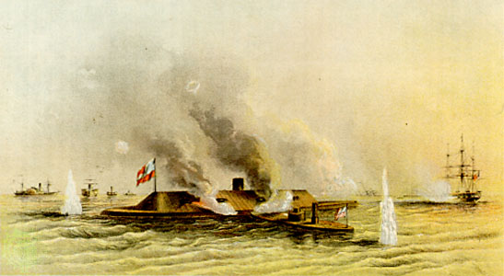
Ironclads: the Monitor vs. the Merrimack
At the Battle of Hampton Roads on March 9, 1862, the Union’s Monitor fought the Confederacy’s Merrimack (aka CSS Virginia) to a draw (actually a strategic victory for the Monitor, because it prevented the Merrimack from breaking the Union blockade). The Monitor is the smaller of the two shown here.
The introduction of ironclad warships made every navy in the world (all wooden ships) obsolete.

Slide 25
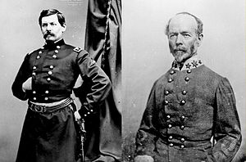
The Peninsula Campaign
Union General George McClellan landed his 104,000-man army on the Virginia Peninsula in March 1862, planning to capture the Confederate capital, Richmond.
At first McClellan (left), who was known as an extremely cautious commander, did well against the equally cautious Confederate General Joseph E. Johnston (right).

Slide 26
Lee Takes Over
When Johnston was replaced by the more aggressive General Robert E. Lee, the Confederates gained the advantage.
Lee forced McClellan to retreat back down the peninsula in six battles from June 25 to July 1, 1862 (known as the Seven Days’ Battles).
The Union actually won all six battles, but McClellan treated them as defeats and kept retreating anyway!
McClellan, whose army outnumbered Lee’s 92,000 man army by 12,ooo men, always thought he was actually outnumbered and kept requesting more troops.
When it was over, the Union had lost 15,855 casualties; the Confederates had lost 20,204, but McClellan gave up and retreated to Washington, D.C., saying he’d never had enough troops.

Slide 27
The Trouble With Union Generals
Lincoln, who had already fired McDowell as commander of the Union’s Army of the Potomac after the humiliation at Bull Run, now fired McClellan from the same command.
He replaced McClellan with General John Pope; later fired Pope and gave McClellan another try;
Fired McClellan for good and replaced him with General Joe Hooker; fired Hooker and replaced him with General Ambrose Burnside;
Fired Burnside and replaced him with General George Meade;
And finally put General Ulysses S. Grant in charge in 1864 – Grant kept command for the rest of the war.

Slide 28
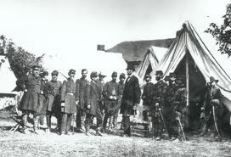
Lincoln and His Generals
Lincoln meeting with officers of the Army of the Potomac – note how much taller Lincoln is than most everyone else – at 6 foot 4 in his bare feet, Lincoln was about 9 inches taller than the average man in the 1860s.

Slide 29
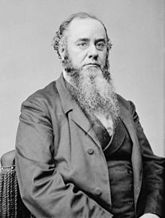
Edwin M. Stanton
Lincoln wasn’t the only one who was sick of McClellan: Secretary of War Edwin M. Stanton said of McClellan: “if he had a million men, he would swear the enemy had two millions, and sit down and wait until he had three.”

Slide 30
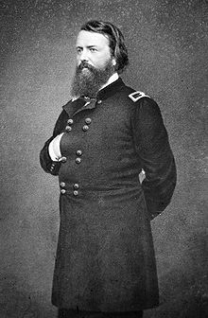
The Second Battle of Bull Run (called Second Manassas by the South)
August 28-30 1862: Union General John Pope’s 62,000-man army was attacked and defeated by Lee’s 50,000-man Confederate Army; once again, General Stonewall Jackson played a key role in the South’s victory.
Lincoln then replaced Pope with McClellan (again) as commander.

Slide 31
Battle of Antietam (Sharpsburg)
September 17, 1862: still the bloodiest single day in American history.
Lee had invaded the North (Sharpsburg is in Maryland), planning to attack Washington, D.C. and force the Union to surrender.
A Union patrol found a copy of Lee’s battle plans and delivered it to McClellan – instead of attacking immediately, McClellan waited over 24 hours and failed to destroy Lee’s army.
Union strength at this battle was 75,500 soldiers vs. just 38,000 Confederates in Lee’s army.

Slide 32
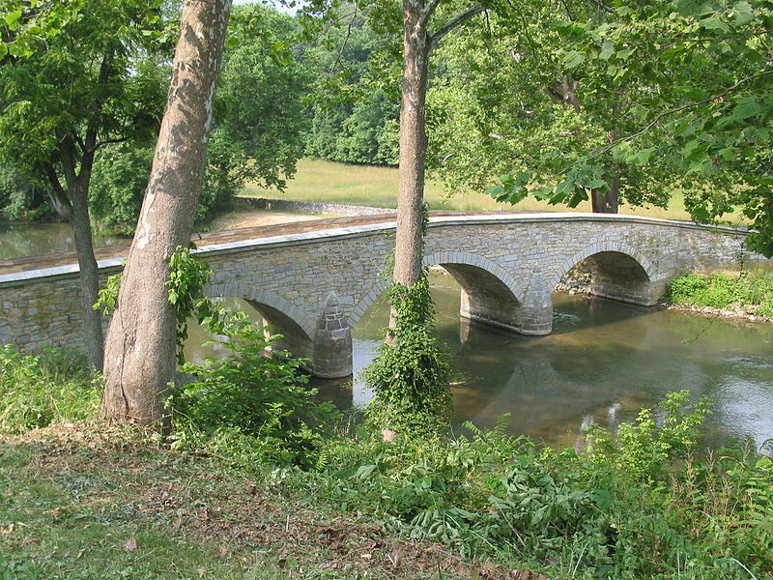
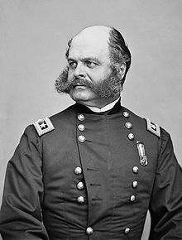
Antietam
Fighting in the morning was centered around a cornfield near Antietam Creek, outside Sharpsburg.
In the afternoon, McClellan ordered Burnside to attack the Confederate flank across Antietam Creek – although the creek was shallow enough to wade across, Burnside ordered his 14,000 men to cross at what’s now called “Burnside Bridge” – this created a bottleneck that allowed just 450 Confederate sharpshooters to hold off Burnside’s entire force for several hours.

Slide 33
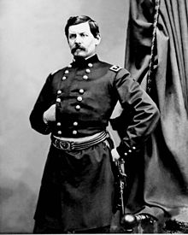
Antietam
Due to heavy casualties, Lee retreated back into Virginia the next day.
McClellan had won a strategic victory by stopping Lee’s invasion of the North,
But he could have won the war if he’d pursued Lee.
Lincoln ordered McClellan to pursue Lee’s army; when he didn’t do it, Lincoln fired him (for good)!
McClellan: “They have made a great mistake. Alas, for my poor country.”

Slide 34
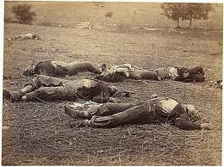
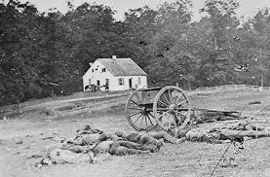
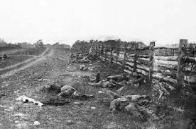
Mathew Brady soon opened an exhibit called “The Dead of Antietam” at his New York gallery
The photos shocked viewers – most had only seen sketches and paintings of battle scenes before – the reality of photographs stunned them.

Slide 35
Aftermath of Antietam
Casualties: 12,401 for the Union; 10,316 for the Confederates – the bloodiest day in American history.
Still, the Union’s strategic victory at Antietam allowed Lincoln to announce something that he’d decided to do a month earlier, but didn’t want to reveal until the Union had won a big victory:
The Emancipation Proclamation: Lincoln announced it on September 22, 1862, to go into effect on January 1, 1863: all slaves in the Confederacy were to be set free by that date.
Now, the war wasn’t just about preserving the Union, but about ending slavery as well, which Lincoln knew should help the Union win, because:
It meant that Britain and France, which opposed slavery, would no longer support the South.

Slide 36
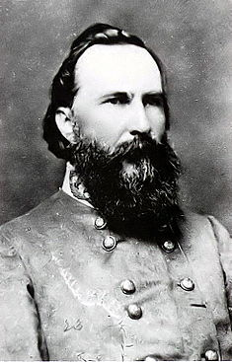
Battle of Fredericksburg
General Burnside was now in command of the Union Army of the Potomac – planned to cross the Rappahannock River in mid-November 1862, then race on to capture Confederate capital at Richmond before Lee’s army could stop him.
Spent two weeks crossing the river; gave Lee time to fortify in Fredericksburg – Burnside’s army would have to attack by charging uphill for over a mile at well-positioned rebel defenses. Many of Lee’s men, under General James Longstreet (right), were shooting from behind a stone wall.
Burnside had 114,000 troops vs. just 72,500 for Lee.

Slide 37
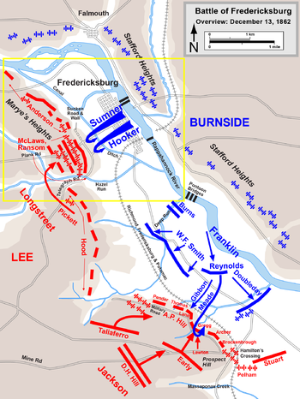
Fredericksburg
Burnside attacked on December 13, 1862.
Because Lee’s troops were in such a good position, Burnside’s troops were slaughtered – 12,653 Union casualties at Fredericksburg (5,377 Confederate casualties).
This humiliating defeat badly hurt Union morale, and led to Lincoln relieving Burnside of command.

Slide 38
The Battle of Chancellorsville: Lee’s “Perfect Battle”
Battle was May 1-6, 1863 near Chancellorsville, Virginia.
Lee’s Army of Northern Virginia was outnumbered, 120,000 to 55,000, by the Union Army under General Joe Hooker.
Hooker had better intelligence than McClellan had had in earlier battles against Lee (Pinkerton detective agency had often overestimated Lee’s numbers then).
Hooker knew he had Lee outnumbered and planned to simultaneously attack Lee from both front and back – a trap!

Slide 39
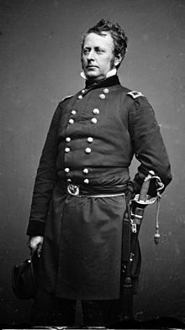
General “Fighting Joe” Hooker
Hooker said, “May God have mercy on General Lee, for I will have none.”
By the way: prostitutes are NOT called “hookers” because so many prostitutes followed Hooker’s army – yes, many did follow his army, but prostitutes had already been called “hookers” at least 13 years earlier (the term was used in a magazine in 1850).
Still, so many people THINK that the term “hooker” is because of General Hooker that it helped popularize the term in the future!

Slide 40
Chancellorsville
Surrounded by Hooker’s army, Lee reversed the trap by dividing his troops – very risky – and sending 28,000 men led by Stonewall Jackson to attack Hooker’s right flank.
This left Lee with only 12,000 men facing 70,00o Union troops on Hooker’s front.
Hooker was so surprised by Jackson’s force hitting his flank that he thought Lee must really have had another army somewhere nearby, and never realized that Lee’s front was weak and could easily be broken.
When a stray cannon shell nearly hit Hooker, he lost his nerve and decided to retreat – Lee had won.

Slide 41
After Chancellorsville
Lee had won his greatest victory ever, but also had one of his greatest losses – Stonewall Jackson was killed at Chancellorsville.
After defeating Hooker’s right flank, Jackson had gone out on a night reconnaissance – some of his own troops accidentally shot him as he rode near them in the darkness, thinking he was a Union spy.
Jackson’s left arm had to be amputated – he appeared to be recovering, but caught pneumonia and died several days later.
Lee said “I have lost my right arm.” It was true – Lee depended so much on Jackson, losing him hurt Lee’s chances of success in future battles.

Slide 42
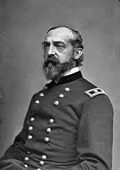
Gettysburg: The Turning Point
After Chancellorsville, Lee (top) decided to invade the North again, hoping to capture D.C. and force the Union to recognize the Confederacy’s independence.
General George Meade (bottom) replaced Hooker as commander of the Union army – Meade followed Lee into Pennsylvania, carefully keeping his army between Lee’s army and Washington, D.C.
The turning point of the war, Gettysburg continues to be famous in pop culture: https://www.youtube.com/watch?v=p8fHdD5x9pY

Slide 43
Gettysburg
The Battle of Gettysburg began July 1, 1863, when a Union patrol accidentally ran into part of the Confederate army at the town of Gettysburg, Pennsylvania.
A short fight ensued before darkness fell.
Reinforcements from both armies arrived throughout the night.
By July 2, about 90,000 Union troops were facing about 65,000 Confederates – this is still the largest battle that has ever been fought in the Western Hemisphere.
It was the turning point of the Civil War – the Union victory at Gettysburg turned the whole war in favor of the Union.

Slide 44
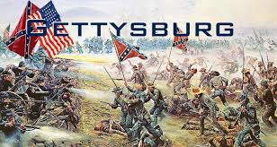
Gettysburg: Big and Little Round Top; Pickett’s Charge

Slide 45
Gettysburg
The Confederates nearly won the battle on July 2 – the Union barely held off the last Confederate attack.
On July 3, Lee ordered a fresh division of 12,500 troops led by General George Pickett to attack the Union center – Pickett’s Charge.
Pickett’s men had to charge across a mile of open field into the Union guns – over 50% of Pickett’s force were killed or wounded, and the attack failed.
The failure of Pickett’s charge forced Lee to retreat.
Meade failed to pursue and capture Lee’s army, which could have won the war, allowing Lee to escape back to Virginia.
Combined, the North and South suffered 51,000 casualties at Gettysburg.

Slide 46
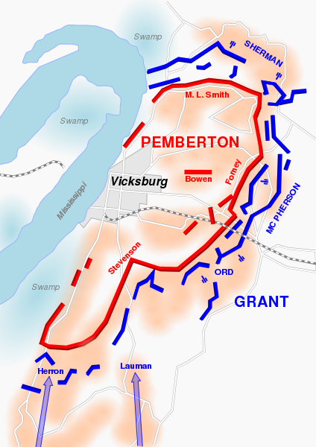
Vicksburg
The same day (July 4, 1863) that Lee began his retreat from Gettysburg, Grant’s Union army captured Vicksburg, Mississippi after a two-month siege.
The Confederate commander, General John Pemberton, surrendered on the 4th of July because he was a former northerner and claimed the Yankees would give the best surrender terms on Independence Day.
This gave the Union control of the entire Mississippi River, cutting the South in half.
Vicksburg is seen as another part of the turning point of the war – once the Union won at both Gettysburg and Vicksburg, Union victory in the entire war was only a matter of time.

Slide 47
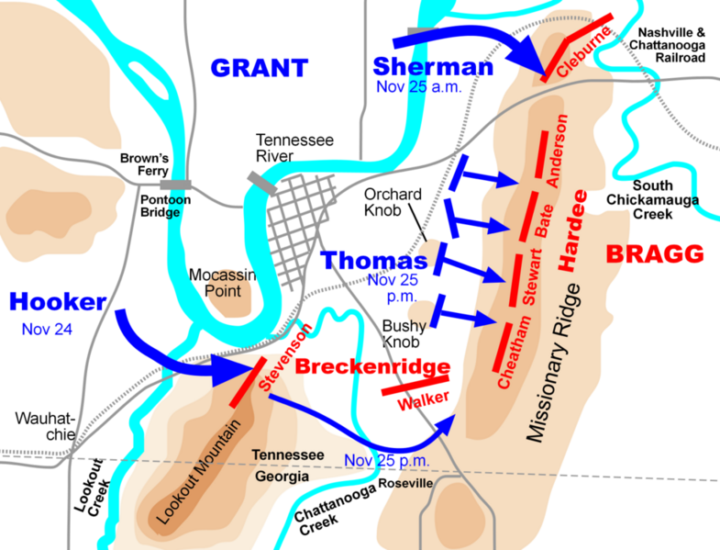
Chattanooga
Key Confederate rail center of Chattanooga, Tennessee was captured by Grant’s Union army on November 25, 1863 after a series of three battles during the previous months.
Fighting at Chickamauga on August 21, 1863 was especially bloody – nearly 18,000 Confederate and 17,000 Union soldiers were killed or wounded.
Union eventually wore down the smaller Confederate army and captured the city.

Slide 48
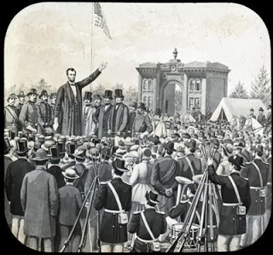
The Gettysburg Address
November 19, 1863: Lincoln was invited to make a few “appropriate remarks” at the dedication ceremony for the new national cemetery at Gettysburg battlefield.
Featured speaker Edward Everett spoke first – for two hours!
Lincoln’s speech only lasted about two minutes – when it was over, he thought it had been a failure, but Everett complimented him on it.
Lincoln’s critics used the speech as an example of what an “embarrassment” Lincoln was as president.
Today, of course, it is seen as one of the great speeches of all time.

Slide 49
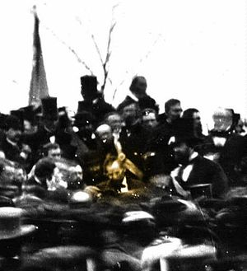
Lincoln at Gettysburg
One of two confirmed photos of Lincoln at Gettysburg the day he gave the Gettysburg Address.

Slide 50
Partial view of the engraving of Lincoln’s Gettysburg Address at Gettysburg Battlefield

Slide 51
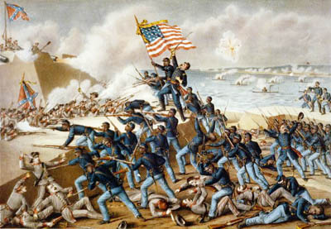
African American Troops
After the Emancipation Proclamation, the Union began raising soldiers for the USCT (United States Colored Troops).
Nearly 200,000 African Americans – some escaped slaves, most free men from the North – volunteered to serve in the Union Army.
Most famous was the 54th Massachusetts, led by Colonel Robert Gould Shaw, a white officer from Boston (all colored troops had white officers – colored troops were not allowed to be officers themselves).
Colonel Shaw and about half of the 54th were killed in a failed attempt to capture Ft. Wagner, near Charleston, S.C. (right).
Fort Shaw, Montana, was later named after Colonel Shaw.

Slide 52
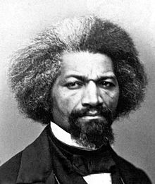
Frederick Douglass
Born a slave in 1818, Douglass escaped to the North in 1838.
He became one of the best-known abolitionists and also a women’s suffrage activist.
Douglass was a huge advocate for the Union army to create the USCT, arguing that since the war (after the Emancipation Proclamation) was now being fought to end slavery, blacks should help fight for their freedom.
He once said: “If anyone asks you, ‘Will a slave fight?’ Tell him no. But if he asks, ‘Will a Negro fight?’ Tell him yes.”

Slide 53
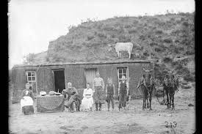
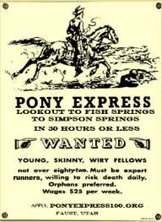
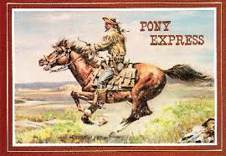
Out West During the Civil War
The Homestead Act was passed in 1862 – over 300,000 people moved west of the Mississippi during the war.
Construction on the first transcontinental railroad began in 1863.
Pony Express delivered mail from St. Joseph, Mo., to Sacramento, Ca., from April 1860 to October 1861 – then was replaced by telegraph.

Slide 54
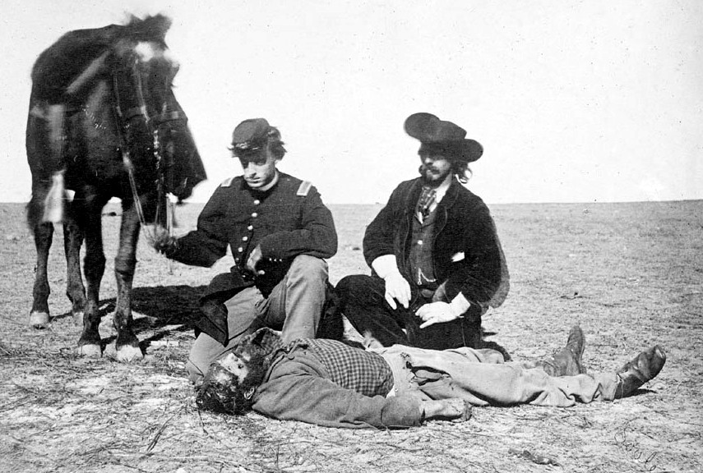
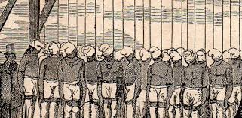
Indian Uprisings During the Civil War
Combination of troops being sent back east to fight in the Civil War and also payments and supplies promised to tribes not getting delivered on time (due to the war) led to major Indian uprisings in Minnesota (Sioux) and Colorado (Cheyenne), with many white settlers killed.
Reprisals by U.S. government led to 400 Sioux being sentenced to death in Minnesota (but Lincoln commuted sentence for all but 38 of them) and the horrific Sand Creek Massacre of over 200 innocent Cheyenne Indians by the Colorado 3rd Volunteer Militia led by John Chivington.

Slide 55
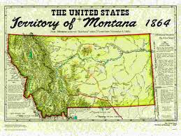
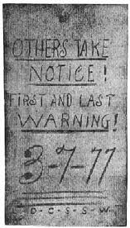
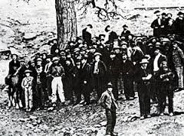
Montana Became a Territory During the Civil War
In 1864, Montana became a U.S. Territory thanks to our population increase due to the Montana gold rush.
Widespread crime and vigilantism occurred in Montana during the Civil War, with northerners and southerners often opposing each other.
Arizona, Nevada, and Idaho also became territories in 1864.

Slide 56
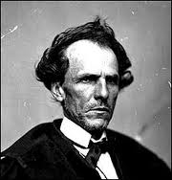
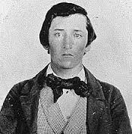
Guerilla War in Kansas and Missouri
Some of the Civil War’s bloodiest fighting happened out west in Kansas and Missouri – although casualties weren’t as high as in the large battles back east, civilians were often targeted out west.
Union guerilla fighters led by Senator Jim Lane (top) were called Jayhawkers; Confederate guerillas were called Bushwhackers or Quantrill’s Raiders after famous Confederate guerilla leader William Quantrill (below).

Slide 57
The Lawrence Massacre
Quantrill and his lieutenant, Bloody Bill Anderson (right), led 450 Confederate guerillas into the pro-Union town of Lawrence, Kansas on August 21, 1863.
Main goal was to kill Jim Lane, but he escaped through a cornfield.
Proceeded to kill 183 men and boys “old enough to carry a rifle” (ages 14 to 90).
Union army retaliated by evacuating and burning three Missouri border counties and part of a fourth.

Slide 58
Deaths of Quantrill and Anderson
Anderson massacred 24 unarmed Union troops at Centralia, Missouri on September 27, 1864.
Anderson was killed in a Union ambush on October 26, 1864, but his lieutenant, Jesse James (right), escaped.
Quantrill was killed in a Union ambush in Kentucky in 1865.

Slide 59
Grant in the East
No Union general had consistently able to defeat General Lee – because of his success in the western theater of the war, Lincoln put Ulysses S. Grant (top) in charge of the Union Army of the Potomac – to defeat Lee (below).
While Lee was clever like a fox, Grant was compared to a bulldog – nothing fancy, but always attacking, holding onto the enemy and not letting go.

Slide 60
Grant’s Strength
Skeptics admitted that Grant had been very successful so far, “but he never met Bobby Lee.”
His friend General William T. Sherman (top) said: “I’m a damn sight smarter than Grant… but I’ll tell you where he beats me and where he beats the world: he don’t care a damn for what the enemy does out of his sight. But it scares me like hell.”
Grant’s calm and cool attitude was his greatest strength as a leader.

Slide 61
Grant vs. Lee
Grant fought Lee’s army from May 1864 to April 1865.
At first, Lee often won individual battles, but instead of retreating, Grant kept attacking.
That summer, Grant lost more men than Lee had in his entire army – but still kept attacking.
Grant did this because he knew he had a huge manpower advantage – basically, Lee would run out of soldiers before Grant did, so Grant would win in the end.
Not everyone appreciated Grant’s strategy – Mary Lincoln (the president’s wife) called Grant “a butcher” because so many of his men were killed and wounded.

Slide 62
Petersburg
Lee retreated to Petersburg, Virginia, in June 1864.
Grant surrounded nearby Richmond (the Confederate capital) – if Grant could break through Lee’s defenses at Petersburg, he could capture Richmond and win the war.
The fighting at Petersburg settled in to a long siege – from summer 1864 to spring 1865, the two armies fought against each other in an early version of trench warfare (top: abatis in front of Union trench lines; below: Union trench line including abatis and sharpened stakes called fraises).
Attacks against defenses were suicidal – almost impossible to succeed – sometimes, veteran soldiers refused to charge when ordered.

Slide 63
The Crater
General Burnside (right) had a regiment of Pennsylvania coal miners led by Colonel Henry Pleasants (left) dig a 511-foot tunnel under the Confederate defenses at Petersburg.
4 tons of explosives were placed in the tunnel and detonated under Confederate Fort Pegram and blown up at dawn on July 30, 1864.
Killed 278 Confederate troops instantly, left a crater 30 feet deep, 70 feet wide, 250 feet long.
Union troops were supposed to immediately charge through the opening, capture the Jerusalem Plank Road, capture Richmond, and win the war.

Slide 64
Disaster at the Crater
Instead of attacking immediately after the explosion, Union assault forces waited up to an hour before charging.
Instead of charging around the crater, they charged into it.
Had no ladders, no way to climb up the crater wall; they were easy targets for Confederates who gathered around the top of the crater and shot down at them. Union lost 3,800 casualties vs. just 1,400 Confederate casualties.
Black Union troops were shot by Confederates while trying to surrender (whites were taken prisoner).
Burnside was given extended leave and never recalled to duty.

Slide 65
General Phil Sheridan
While the siege at Petersburg continued, Union troops led by General Phil Sheridan (top) protected Washington, D.C. from possible attack by Confederate cavalry led by General Jubal Early (below).
Sheridan also destroyed all crops and food supplies in the fertile Shenandoah Valley, depriving the Confederacy of a major food source.
Sheridan (who was only 5 foot 4) and Sherman were Grant’s two favorite generals from fighting under him in the western theater earlier in the war and continued to win recognition in the east as the war came to an end.

Slide 66
Sherman’s March
General Sherman’s Union army captured Atlanta in September 1864; evacuated the city in November, then burned it to the ground.
The capture of Atlanta greatly helped Lincoln’s reelection chances – showed voters that the Union was really close to winning the war.
Sherman’s army then marched to Savannah (on the Atlantic coast), destroying all towns, farms, railroads, livestock, etc., in a path 60 miles wide – strategy now called “total warfare” designed to force the South to surrender.
Sherman captured Savannah in December 1864.

Slide 67
Images of Sherman’s March
To this day, many southerners hate Sherman, calling him “Burnin’ Billy Sherman” because of the damage his army did in Georgia and (later) South Carolina, as he continued his march in February 1865 with the goal of joining Grant’s army at Richmond.
One of the most famous scenes from “Gone With the Wind” (the most popular movie of all time) recreated Sherman’s burning of Atlanta: https://www.youtube.com/watch?v=IKjP53J6gIE

Slide 68
Election of 1864
Lincoln ran as the Republican candidate against the Democrats’ nominee – his old general, George McClellan, who promised to end the war and make peace with the South if he was elected.
Most of the media wanted McClellan to win.
Lincoln had expected to lose, because the war was not going well, but Sherman’s capture of Atlanta renewed Lincoln’s popularity.
Lincoln easily defeated McClellan to win reelection – he then asked northerners to be forgiving and work toward a lasting peace with the South once the war ended.

Slide 69
Lee Surrenders, the Union Wins the War
March 1865: Grant broke through Lee’s defenses at Petersburg and captured Richmond.
Lee tried to flee west with his army to continue fighting, but was cut off by a second Union army.
April 9, 1865: Lee realized that “there is nothing for me to do but go and see General Grant, and I would rather die a thousand deaths.”
Lee met with Grant that day at Appomattox Court House, Virginia, and surrendered his Army of Northern Virginia to Grant.
All other Confederate generals surrendered by June 1865.

Slide 70
Southerners Took Losing Hard
One southern soldier told a Union officer he surrendered to: “You may forgive us, but we won’t be forgiven. We hate you.”
Some southerners still call the Civil War “the War of Northern Aggression” – when one poor rebel soldier (who obviously couldn’t afford to own slaves) was asked why he bothered to fight so hard, he simply told the Union soldiers who captured him: “because you’re down here.”

Slide 71
Edmund Ruffin: Confederacy or Death
Edmund Ruffin, a wealthy planter who’d fired the first shot of the war at Fort Sumter, wrapped himself in a rebel flag and shot himself when the war ended; his suicide note said he’d “rather die than live in a reconstructed Union populated by members of the Yankee race.”

Slide 72
Lincoln is Assassinated
While watching a play with his wife at Ford’s Theater in Washington, D.C., Abraham Lincoln was assassinated by famous actor and southern sympathizer John Wilkes Booth (top) on April 14, 1865.
Lincoln was the first president to be assassinated – he was succeeded by his vice president, Andrew Johnson (below).
Booth escaped from D.C., but was shot dead by Union troops at Port Royal, Virginia on April 26, 1865.

Slide 73
The Booth Conspirators
Eight others were arrested as Booth’s accomplices and found guilty on June 30, 1865:
Mary Surratt, Lewis Powell, David Herold, and George Atzerodt were hanged on July 7, 1865; three others got life sentences in prison, and one was sentenced to six years.
Many historians believe Mary Surratt’s only crime was owning the boarding house in which Booth and the other conspirators met.
Surratt was the first woman ever executed by the U.S. federal government.
In 1869, President Andrew Johnson pardoned the conspirators who’d been sent to prison – except one, who’d died of yellow fever while in prison.

Slide 74
After Slavery
New ways of life:
Southern landowners lost nearly everything due to the Union Army’s total warfare.
Blacks (and poor whites) became tenant farmers and sharecroppers (top right) – no longer slaves, but still dirt poor with no way to improve their lives.
Many former slaves moved to cities in the North or moved to the West and filed claims as homesteaders (below right) on the Great Plains (these were often called “Exodusters”).

Slide 75
The Freedmen’s Bureau
Formed by Congress and headed by General Oliver O. Howard to help African Americans adjust to life after slavery.
Sent teachers to the South to educate blacks; founded schools and colleges, like Howard University.
Helped former slaves find jobs.
Tried, but failed, to give former Confederate land to former slaves.
Despite some success, the Freedmen’s Bureau was shut down when Reconstruction ended in 1877.

Slide 76
Reconstruction: To Punish or Forgive?
Presidential Reconstruction – Lincoln’s Plan.
Make it easy to pardon southerners – once 10% of voters from a southern state signed a loyalty oath to the Union, that state would be readmitted to the Union.
Blacks who were literate or had served in the Union Army would be allowed to vote.
This plan focused on forgiving the South – but Lincoln was assassinated before this plan could go into effect.

Slide 77
Reconstruction: To Punish or Forgive?
Radical Republicans’ plan: punish the South!
Contended that southern state governments had committed “state suicide” when they seceded from the Union and no longer existed.
South would be placed under military rule – divided into districts governed by the U.S. Army with a general as military governor.
Southern states could only be readmitted to the Union after writing new state constitutions (that had to be approved by Congress) and ratifying the 14th and 15th Amendments.

Slide 78
Reconstruction: To Punish or Forgive?
Presidental Reconstruction: Johnson’s Plan – forgive the South.
Southern states could be readmitted to the Union by simply doing the following:
Repeal secession
Repudiate (refuse to pay) their war debts
Abolish slavery
Return of traditional (white) southern leadership would then be permitted.

Slide 79
Black Codes
Southern states under Johnson’s reconstruction passed laws limiting the rights of newly-freed blacks. For example:
Blacks were not allowed to vote, testify against whites at trials, handle weapons, or serve on juries.
Unemployed blacks could be declared vagrants and put in jail – if a white man paid their bail, they then had to work for him – for free – until they had worked off their debt to him.

Slide 80
Civil Rights
1865: Thirteenth Amendment changed the Constitution to outlaw slavery.
1866: Civil Rights Act granted citizenship to all African Americans.
1868: Fourteenth Amendment granted citizenship to all people “born or naturalized” in the U.S. (including African Americans).
1869: Fifteenth Amendment protected right of all citizens to vote (so southern states could not pass laws saying black citizens couldn’t vote).

Slide 81
Radical Reconstruction
In 1867, the Radical Republicans who controlled Congress overrode President Johnson’s veto and passed the Reconstruction Act.
The Reconstruction Act abolished the South’s new state governments and put the South under military rule until the Radical Republicans’ conditions for reconstruction had been met.
Carpetbag government: under Radical Reconstruction, local government in the South was controlled by:
Northerners who had moved to the South to take government jobs (carpetbaggers) and
Pro-Union Southerners (scalawags);
Most white Southerners considered this government corrupt.

Slide 82
Impeachment of President Johnson
Andrew Johnson became the first president to be impeached when the Radical Republicans in the House of Representatives impeached him for breaking the Tenure of Office Act.
Johnson believed the law was unconstitutional and broke it on purpose by firing Secretary of War Stanton – he was then impeached by the House.
In the Senate, Johnson missed being removed from office by 1 vote (35-19) in May 1868.
He finished his term, but was weak and ineffective.

Slide 83
President Ulysses S. Grant
Grant was elected president in 1868 and reelected in 1872.
His term was marred by charges of corruption – Grant himself was honest, but others in his administration abused their power, accepted bribes, etc.

Slide 84
Birth of the Ku Klux Klan
https://www.youtube.com/watch?v=raVFzZZLp3A
To resist Reconstruction and keep blacks from exercising their new rights, former Confederates led by General Nathan Bedford Forrest formed the Ku Klux Klan in Tennessee in 1866.
Forrest later quit the Klan when it got too violent, even for him.

Slide 85
Grant vs. the KKK
Grant’s greatest success as president may have been his action against the Ku Klux Klan.
The KKK had been terrorizing southern blacks: burning crosses, lynching black men, intimidating blacks to keep them from voting, etc.
President Grant used the army to destroy the KKK; it would not be a major force again until after World War I, about 50 years later.

Slide 86
Politics End Reconstruction
The end of Reconstruction actually started with the 1876 presidential election.
The election was very close between Republican Rutherford B. Hayes (left) and Democrat Samuel Tilden (right); Tilden won the popular vote and led in the electoral vote – but 20 electoral votes were still unresolved.

Slide 87
The Compromise of 1877
Although Tilden had probably won the election, Democrats (nearly all white southerners were Democrats until the 1960s) would rather end Reconstruction than have a Democrat as president – ending Reconstruction was that important to them.
So, Democrats in Congress agreed to support Hayes (the Republican) for president; in return, Republicans in Congress agreed to end Radical Reconstruction.
By the end of 1877, Radical Reconstruction was ended, federal troops were withdrawn from the South, and white-dominated state governments were restored in the South.

Slide 88
After Reconstruction
The South gradually became more industrialized.
With the end of the Freedmen’s Bureau, real gains for African Americans didn’t come until well into the 1900s.
Segregation was legalized in the South by “Jim Crow” laws – which were upheld as constitutional in the Supreme Court case, Plessy v. Ferguson in 1896 under the “separate but equal” doctrine, i.e., it was legal to have separate schools for whites as long as there were also schools for blacks, etc.
Homer Plessy (right) was a creole of 1/8 “colored” blood who illegally rode a white-only streetcar in New Orleans in 1892 – he sued, claiming the “white-only” law was unconstitutional, but the law was upheld under “separate but equal.”

