Slide 1
America Since Watergate
U.S. History
Dr. Donnelly

Slide 2
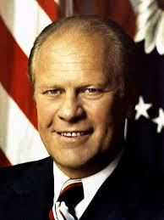
President Gerald Ford
Ford, a Republican, was president from 1974-77 (succeeded from VP to president when Nixon resigned).
Had to face a public and Congress that were suspicious of the White House, high inflation, and being the butt of many jokes on the new hit TV show, Saturday Night Live.
Lost his bid for re-election to Democrat Jimmy Carter in 1976 (Carter took office January 20, 1977).
Notes:
Both houses of Congress had been taken over by the Democrats, including many “Watergate babies” – new members elected in the wake of the Watergate scandal in 1974 who were dedicated to weakening the “imperial presidency” that many felt had been perpetuated by LBJ and Nixon.

Slide 3
Freedom of Information Act
The Freedom of Information Act, or FOIA, was passed after the Watergate scandal to make the government more transparent.
It requires government records to be open to the public.
“The hippies finally got something right. Just kiddin’. But not really.” Check out this clip, starting at the 2-minute mark: https://www.youtube.com/watch?v=WbNpSWrlESA
Notes:
The video clip is just under 5 minutes long.

Slide 4
Inflation
High spending by Congress led to 12% inflation (increase in prices from one year to the next) in 1974.
Anything over 3% to 5% inflation is usually considered bad – 12% is disastrous.
Luckily, inflation dropped back to 5% by 1976; unfortunately, it would go back up again in the late ‘70s.

Slide 5
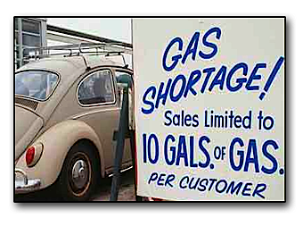
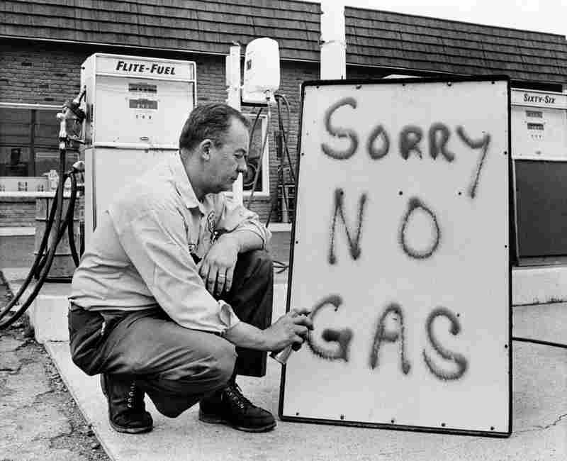
Energy Crisis
Oil was only $1/barrel (and gas was only about 25 cents/gallon!) before 1970.
Then OPEC (Organization of Petroleum Exporting Countries) began raising the price of oil – even embargoed oil to the U.S. in 1973 because the U.S. supported Israel in the Yom Kippur War.
This drove the price of oil up to $17/barrel – raised gas prices, caused panic and gasoline shortages.
Notes:
Yom Kippur War consisted of 13 nations (mostly Muslim & from the Middle East) attacking Israel on Yom Kippur; Israel quickly recovered and won a tactical victory, but the UN settlement favored Egypt.

Slide 6
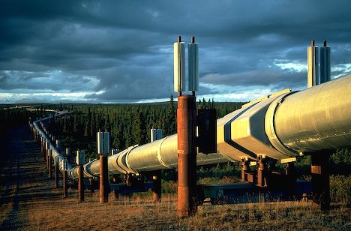
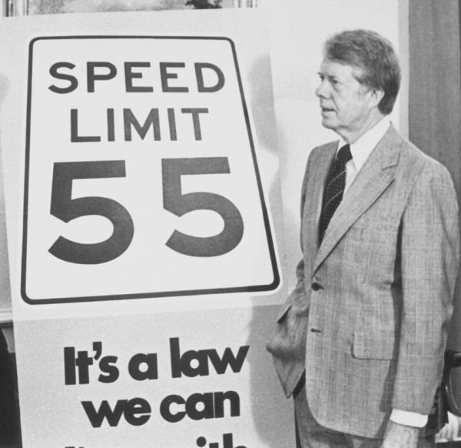
Dealing with the energy crisis
Government plan to deal with the energy crisis included using more coal & nuclear power and completing the Alaska oil pipeline to supply more U.S. oil to compete with OPEC.
Also, states were pushed to enact 55-mph speed limits nationwide (driving slower results in better gas mileage).

Slide 7
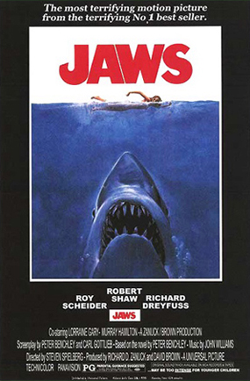
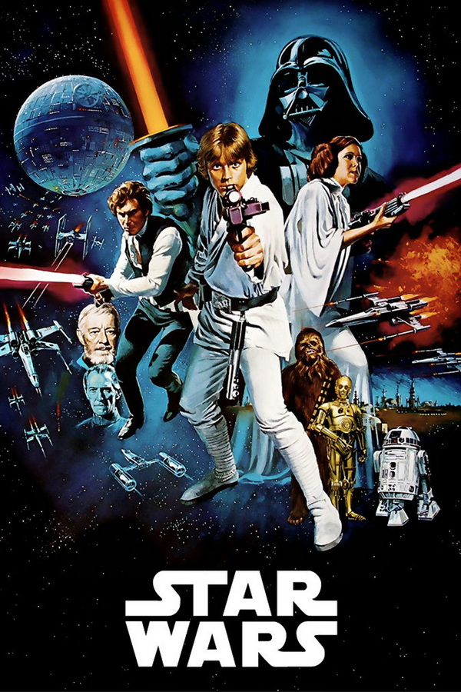
Blockbusters!
In 1975, Jaws became the highest-grossing movie of all time; in 1977, Star Wars broke that record.
These record-setting movies started the modern era of summer blockbuster movies.
President Reagan’s SDI missile-defense program was later nicknamed “Star Wars” – Reagan said, “Why not? It’s a good movie. Besides, the good guys won.”
Notes:
The success of Star Wars increased 20th Century Fox’s stock price from $6 per share to $25 per share.

Slide 8
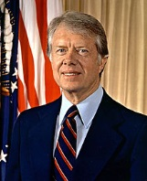
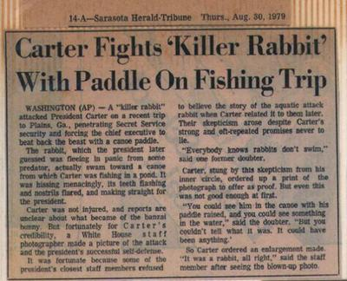
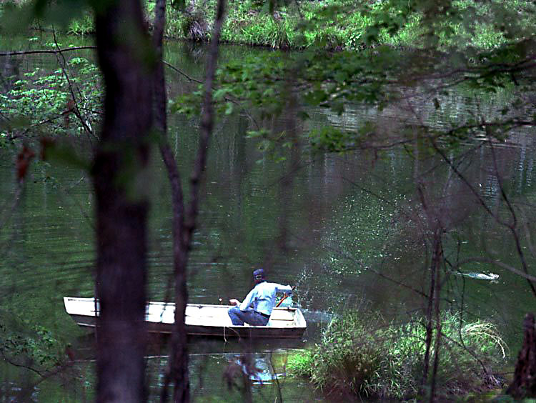
President Jimmy Carter
Carter, a Democrat from Georgia, was president from 1977 to 1981.
He was a navy veteran, a peanut farmer, and former Governor of Georgia.
He is mostly remembered as a weak leader who presided over one of the lowest points in American history.
He’s also the only president ever to have reported seeing a UFO, and claimed to have been attacked by a large swimming rabbit.
Notes:
After Vietnam and Watergate, a big part of Carter’s appeal was that he was not a Washington insider and would not be an “imperial president.” But once he got to the White House, a big problem for him was that he was an outsider who couldn’t influence Congress, leaving him weak & ineffective.
He was still Governor of Georgia when he reported the UFO. The rabbit attack happened on April 20, 1979 while Carter was vacationing in Georgia.

Slide 9
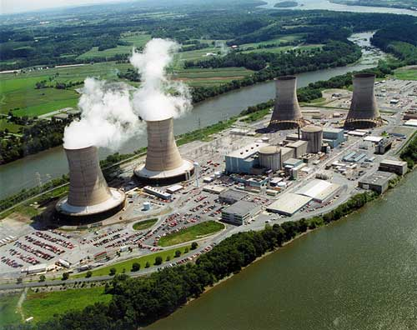
Problems under Carter
High inflation returned, energy crisis continued.
Near-meltdown at Three Mile Island nuclear power plant near Harrisburg, Pennsylvania in 1979 raised fears about nuclear energy – no new nuke plants built in U.S. since then.
SALT II Treaty negotiated by Carter with USSR, but rejected by U.S. Senate.
Oil prices hit $41/barrel by 1979, gasoline prices hit all-time high.
Economy was terrible.
Notes:
The Jane Fonda & Michael Douglas movie The China Syndrome had just opened 12 days earlier than the Three Mile Island incident – since it was about a nuclear power plant meltdown, the Three Mile Island incident seemed to be a real-life “China Syndrome” – but in reality, the amount of radiation people at Three Mile Island were exposed to was only equivalent to what you get by being in a kitchen where a microwave is in use! Proponents of nuclear energy sometimes point out that more people have been killed riding in a car with Ted Kennedy than by nuclear accidents in the U.S!
The USSR had gotten a better deal than the U.S. in the SALT II treaty, partly because intelligence from spy Chris Boyce (Falcon) had allowed them to disrupt our satellite intelligence during the SALT II talks.

Slide 10
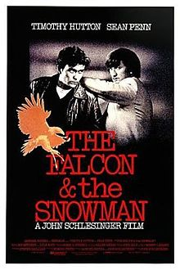
Famous Spies: The Falcon and the Snowman
Christopher Boyce and Andrew Daulton Lee, known by their Soviet code names, Falcon (Boyce) and Snowman (Lee), were arrested in January 1977 and sentenced to prison for espionage for selling secrets about American spy satellites to the USSR.
In January 1980, Boyce escaped from prison and disappeared, robbing 17 banks in Washington, Idaho, and possibly Great Falls, Mt., until being recaptured in August 1981.
They became more famous with the 1985 movie about their lives, starring Timothy Hutton and Sean Penn.
Lee was released from prison in 1998 and Boyce was released in 2002.

Slide 11
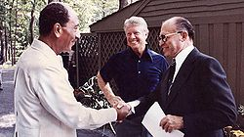
The Camp David Accords
Carter hosted Egyptian President Anwar Sadat and Israeli Prime Minister Menachim Begin at Camp David in 1978.
Israel and Egypt agreed to a peace treaty in 1979 – this was Carter’s main (only?) foreign policy success.
Notes:
Sadat was assassinated in 1981 by faction of the Egyptian military angry he had made peace with the Jews (Israel).

Slide 12
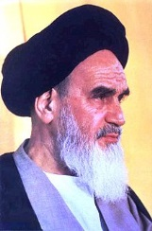
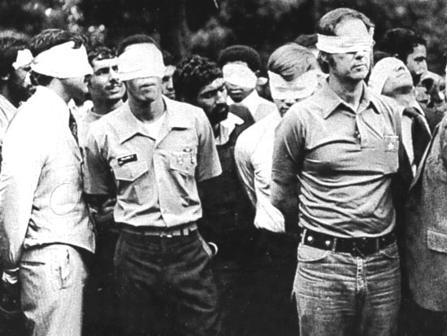
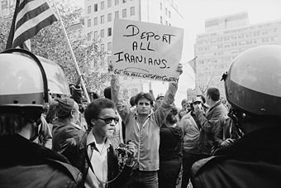
The Iran Hostage Crisis
November 4, 1979: radical Iranian Muslims led by Ayatollah Khomeini take over U.S. Embassy in Tehran (capital of Iran) and take American workers there hostage.
52 Americans were held hostage until January 20, 1981 (444 days).
Carter responded by freezing Iran’s assets in the U.S., stopping import of Iranian oil to U.S., and deporting some Iranians.
Carter’s rescue attempt on April 24, 1980, Operation Eagle Claw, failed – 8 commandos died.
After this, Carter was seen as weak and helpless against Iran.
Notes:
Hostage crisis stemmed from the Shah going to the U.S. for cancer treatment after being forced to flee Iran in January 1979. The Ayatollah and his followers thought the U.S. would try to put the Shah back in power – they wanted him returned so they could execute him. Originally 66 Americans were taken hostage when the embassy was stormed, but 14 were soon released. The ABC news show “Nightline” originated during the Iran Hostage Crisis as a special show dedicated to covering the crisis in depth each day called “America Held Hostage.”

Slide 13
Soviet Invasion of Afghanistan
Christmas, 1979: the USSR invaded Afghanistan and occupied it until 1988.
Again, President Carter seemed helpless.

Slide 14
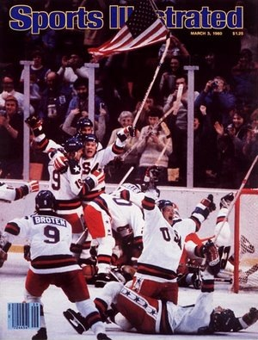
The Miracle on Ice
1980 Winter Olympics at Lake Placid, New York: right after the Soviets invaded Afghanistan, the U.S. hockey team miraculously upset the heavily favored Soviet team, then beat Finland for the gold medal.
This should always be remembered: https://www.youtube.com/watch?v=NYRVZX3J2uQ
Notes:
The video clip is about 4 minutes long.
Remember, the Soviet team had easily beaten not only our Olympic team (who were all amateurs), but even the NHL All-Stars(!) during the months leading up to the 1980 Olympics.

Slide 15
Olympic Politics
In protest of the Soviet invasion of Afghanistan, President Carter announced that the U.S. would boycott the 1980 Summer Olympics in Moscow (USSR) – 61 other countries also joined the boycott.
In 1984, the Soviets (and all the other communist countries) retaliated by boycotting the Summer Olympics in Los Angeles.

Slide 16
Carter’s legacy: ouch…

Slide 17
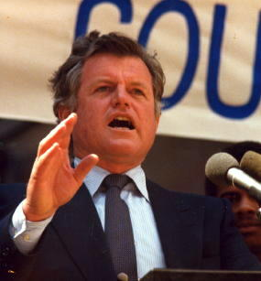
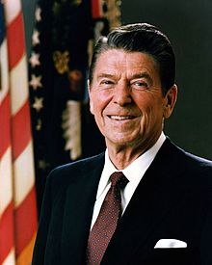
Carter vs. Reagan
By 1980, President Carter’s approval rating was down to a measly 25%.
Ted Kennedy even ran against Carter for the Democratic Party nomination – although Carter held off Kennedy, he had no chance against…
Ronald Reagan, the Republican candidate, who won 489 electoral votes vs. Carter’s 49.
A former actor and governor of California, Reagan had a great sense of humor – he was also the oldest man ever elected president (age 69 in 1980).
Here’s Reagan telling Soviet jokes: https://www.youtube.com/watch?v=mN3z3eSVG7A
Notes:
The video clip is about 6 minutes long.
Reagan famously said, “The nine most frightening words in the English language are, ‘I’m from the government, and I’m here to help.’”

Slide 18
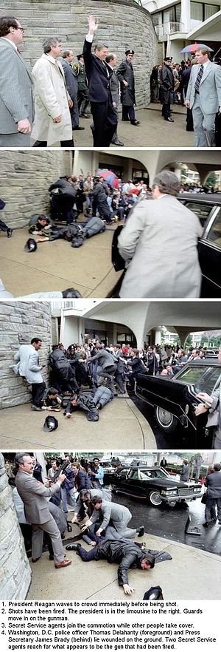
A strong start for Reagan
The day Reagan was inaugurated – January 20, 1981 – the Iran Hostage Crisis ended, as the Iranians set all 52 hostages free.
Reagan appointed the first female Supreme Court justice – Sandra Day O’Connor.
On March 30, 1981, Reagan was shot by lunatic John Hinckley, Jr. – not only did Reagan survive the assassination attempt, his courage and sense of humor (“I hope you guys are all Republicans” he said in the operating room) about nearly being assassinated increased his popularity.
Notes:
Hinckley (still in an insane asylum as of 2015) said he shot Reagan to impress Jodie Foster! When Foster announced a few years ago that she is a lesbian, Hinckley was heartbroken.
Soon after the attempt on Reagan’s life (May 13, 1981) Pope John Paul II also survived being shot by an assassin – a Turkish Muslim named Mehmet Agca. The pope forgave Agca and visited him in prison to tell him so – Agca later converted to Christianity!

Slide 19
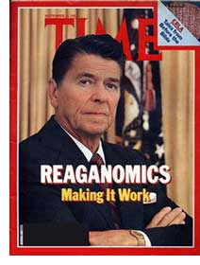
What Reagan Did - Economics
Reagan believed “government is not the solution to the problem – government IS the problem!”
Cut taxes and most government spending, cut number of tax brackets from 15 to 4 to simplify the tax code.
Supply-side economics: tax cuts for wealthy & big business so they would have more money left to hire & pay their employees, which would help the economy.
Even though tax rates were lower, government tax revenues doubled because there were now more people paying taxes.

Slide 20
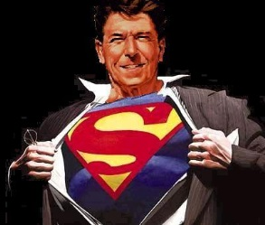
What Reagan Did – The Cold War
Called the USSR an “Evil Empire” – elites were shocked that Reagan would be so “impolite,” but mainstream Americans liked it – and it helped pressure the Soviets to negotiate with us.
Increased military spending - planned to win the Cold War by “spending the Soviets into oblivion.”
This changed U.S. foreign policy from containment of communism to aggressively pressuring the Soviets and really trying to win the Cold War.
Called for more nuclear weapons and placed nuclear missiles in Western Europe to counter Soviet nukes in Eastern Europe.
Notes:
Starting Nov. 2, 1983 and lasting 10 days, our war games in western Europe (Operation Able Archer) were so realistic that the Soviets thought we really were going to attack them – this led them to negotiate with Reagan.

Slide 21
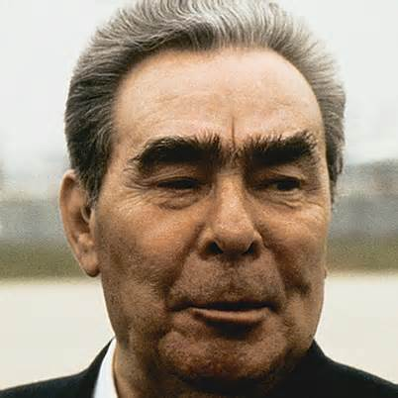
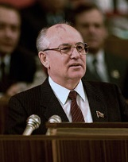
Soviet Leadership Changes
Old Soviet Premier Leonid Brezhnev died in 1982; was replaced by Yuri Andropov, but he died in 1984; was replaced by Konstantin Chernenko, but he died in 1985!
Mikhail Gorbachev then became Premier of the USSR & would remain so until USSR collapsed in 1991.

Slide 22
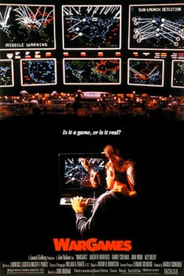
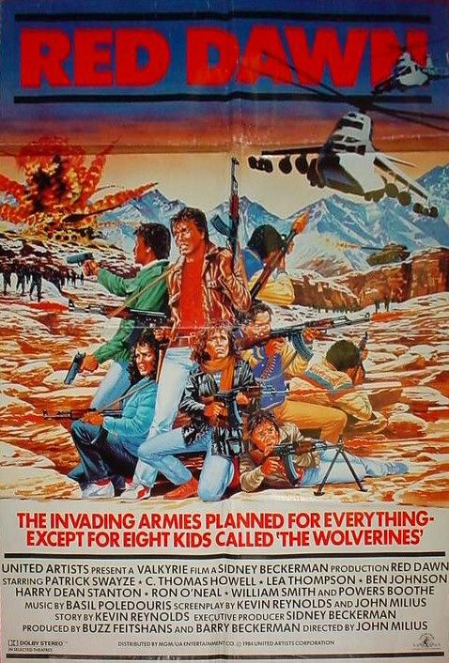
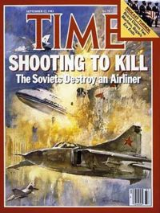
Scary Times
Americans and Soviets lived in fear of nuclear war, reflected by movies like The Day After, War Games, and Red Dawn.
In real life, the Soviets shot down Korean Air Lines flight 007 on Sept. 1, 1983, killing 269 people.
On Sept. 26, 1983, the Soviets almost launched a nuclear attack on the U.S. due to a false missile warning shown by the Soviet Air Defense forces computers – eerily similar to the movie War Games that had come out earlier that year!
Notes:
Soviet officer Stanislav Petrov deserves credit for making the decision NOT to launch missiles that day. But instead of being hailed as a hero, his military career was ruined – he had committed the sin of pointing out that the Soviet system had nearly made a fatal mistake.

Slide 23
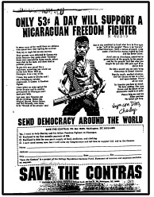
The Boland Amendments
Between 1982 and 1984, Congress passed three riders called the Boland Amendments, which said that no U.S. gov’t. money or training could be used to help anti-communist Contras in Nicaragua to overthrow the communist Sandinista government there.
Reagan opposed the Boland Amendments and encouraged his staff to keep looking for ways to help the Contras.

Slide 24
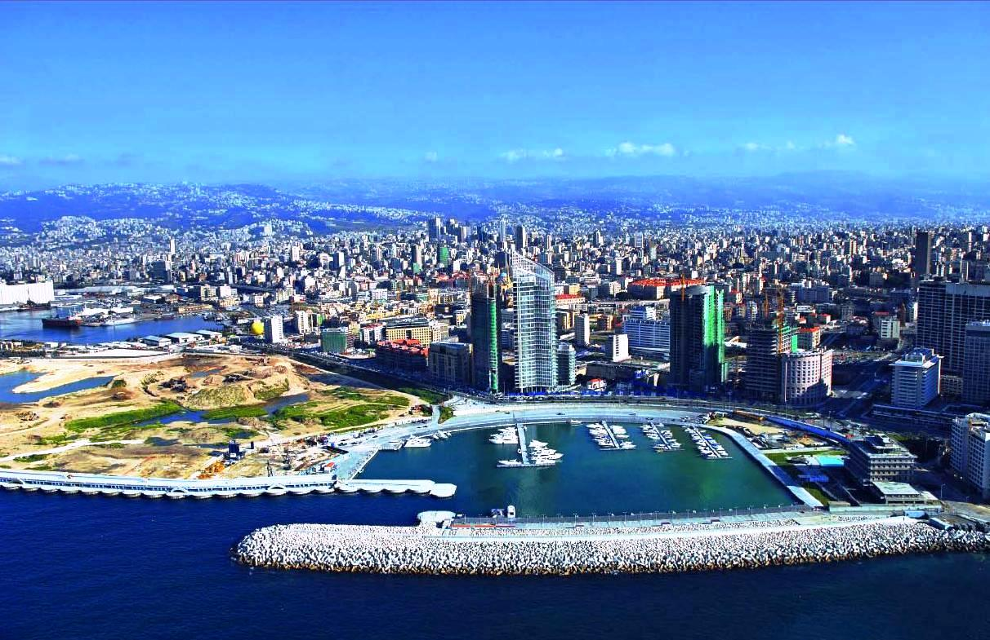
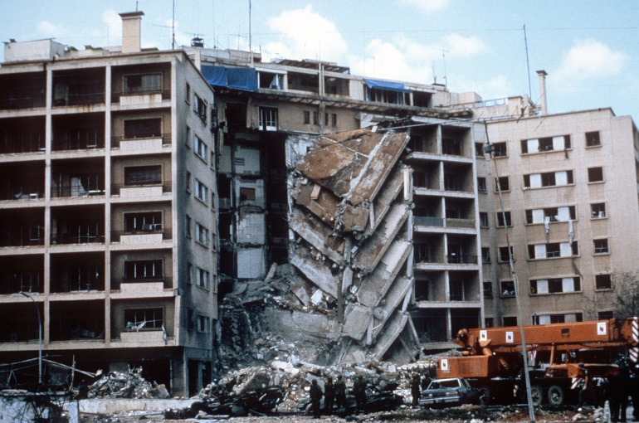
Beirut
Beirut (capital of Lebanon) was once a beautiful city (and now is again) but was being destroyed by battles between Muslims and Christians by the 1980s.
Reagan sent Marines to Beirut to keep the peace & protect Americans who lived & worked there.
Our Marines became targets for terrorists who claimed the U.S. was favoring the Christians.
A suicide bomber blew up one of our Marine barracks on Oct. 23, 1983, killing 220 Marines as they slept.
Reagan then withdrew our troops from Beirut.

Slide 25
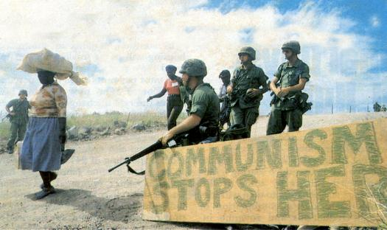
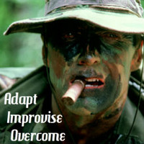
Grenada
October 25, 1983: Reagan sent Marines to Grenada, a Caribbean island under attack by Cuban-backed communist rebels.
Because there were American medical school students on Grenada, the Marines were sent to protect their safety – as well as to support Grenada’s government.
The Marines easily defeated the communist forces.
Notes:
Critics said Reagan just went in to Grenada to save face after the bombing in Beirut. On the other hand, Grenada WAS under attack, and we DID have Americans there to protect.

Slide 26
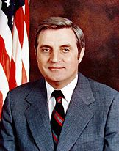
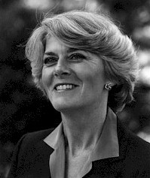
Reagan is Reelected
In the 1984 election, Reagan easily defeated Democrat Walter Mondale.
Reagan won 49 out of 50 states, 525 out of 538 electoral votes, and 59% of the popular vote to Mondale’s 41%.
Reagan’s popularity resulted in the nickname “the Teflon President” (because nothing bad ever stuck to him).
He was also called “the Great Communicator.”
Notes:
Reagan won the most electoral votes ever; Mondale won the second-fewest (Alf Landon in 1936 won only 8). Mondale’s running mate, Geraldine Ferraro, was the first female VP candidate ever selected by one of the two major parties.

Slide 27
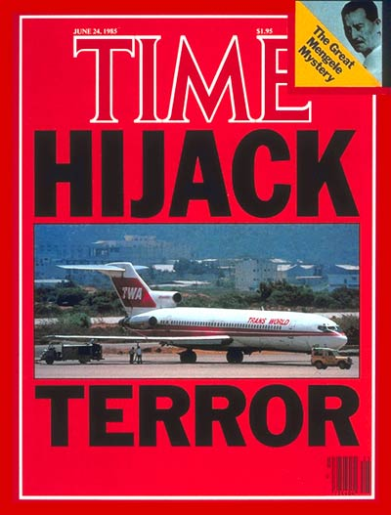
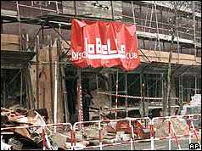
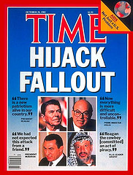
Terrorism in the 1980s
June 14, 1985: TWA Flight 847 from Athens to Rome was hijacked by Muslim terrorists (Hezbollah), who killed an American passenger (Navy Petty Officer Robert Stethem).
October 7, 1985: cruise ship Achille Lauro was hijacked by terrorists, who murdered handicapped Jewish-American Leon Klinghoffer and dumped his body overboard.
April 5, 1986: terrorists bombed a disco in West Berlin, killing 3 U.S. soldiers & a Turkish woman, and wounding 230.
Several airports were also bombed by terrorists.
Notes:
The TWA hijackers released all hostages by June 30, 1985 in exchange for Israel releasing over 700 Shia prisoners and Greece releasing terrorist Ali Atwa.
The Achille Lauro hijackers surrendered in exchange for a flight to Tunisia, but Reagan had the plane stopped in Sicily and the hijackers were arrested – except for their leader, Abu Abbas, whom the Italians released to continue on to Tunisia over U.S. protests.

Slide 28
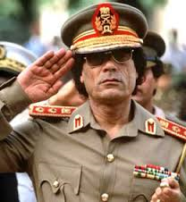
Reagan vs. Quaddafi
Most of the terrorist acts in 1985 and 1986 were linked to Libyan dictator Moammar Quaddafi.
Even Back to the Future had Libyan terrorists: https://www.youtube.com/watch?v=xANWhMQfec4 and the Genesis video “Land of Confusion” captured the anxieties of living with the Cold War and terrorism: https://www.youtube.com/watch?v=1pkVLqSaahk
April 14, 1986: Operation El Dorado Canyon – Reagan ordered air strikes on Libya at Tripoli and Benghazi, which killed dozens of Quaddafi’s top military officers.
Quaddafi himself escaped but was brought to his weakest point since the late 1960s.
Notes:
Quaddafi claimed that his daughter and many civilians had been killed by the airstrikes – this was reported as fact by the media, but later turned out to be a lie.

Slide 29
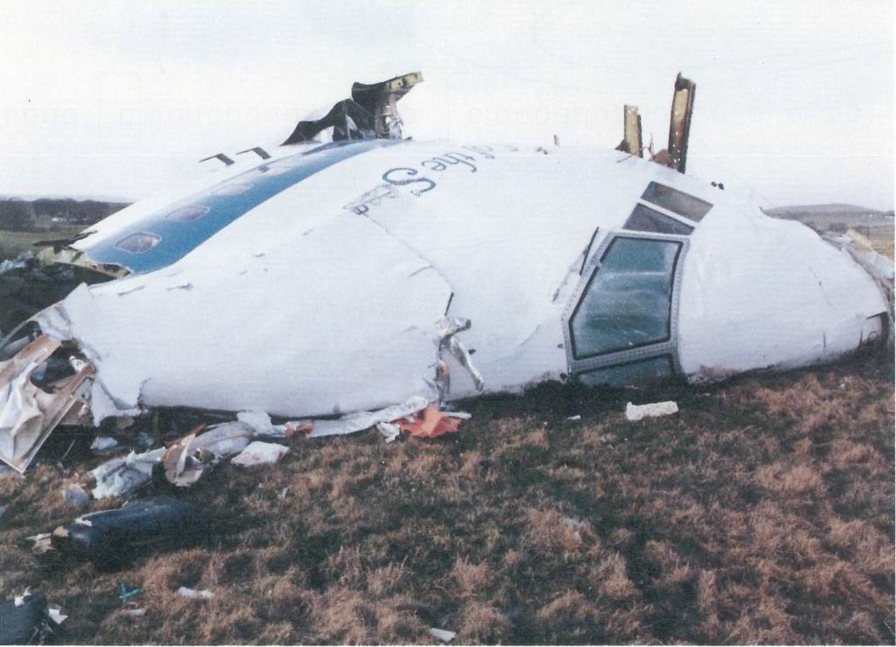
Pan Am Flight 103
December 21, 1988: Pan Am Flight 103 was blown up by Libyan terrorists over Lockerbie, Scotland.
270 were killed, including 11 people on the ground hit by falling wreckage of the Boeing 747 jet.
Quaddafi gave shelter to the two terrorists accused of the bombing, until turning them over in 1999.
In 2003, Quaddafi took responsibility for the bombing and paid $8 million each to the families of all 270 victims.
Notes:
Quaddafi still claimed he had not personally ordered the bombing. Also in 2003, Quaddafi invited UN inspectors to Libya & gave up all of his WMDs – this was in response to the U.S. defeat of Saddam Hussein in Operation Iraqi Freedom that year, which had been carried out partly because Saddam was suspected of still having WMDs (we knew he’d had them previously because he’d killed over 100,000 people with chemical weapons). Quaddafi was overthrown and killed during Libya’s “Arab spring” civil war in 2011.

Slide 30
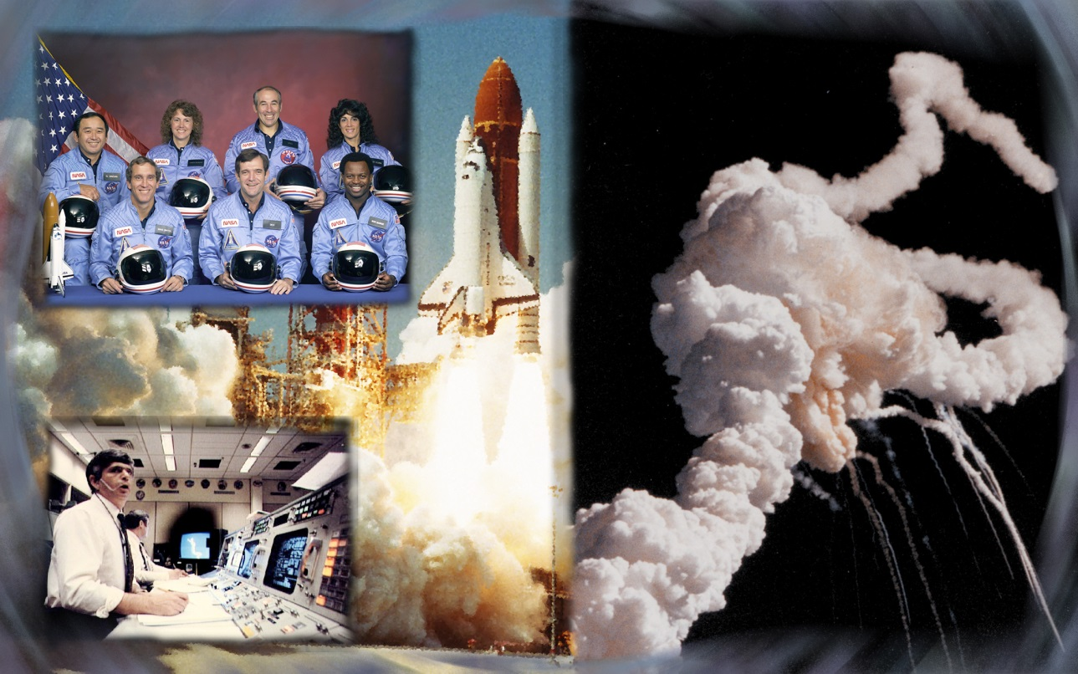
The Challenger Disaster
January 28, 1986: the U.S. space shuttle Challenger exploded shortly after takeoff. https://www.youtube.com/watch?v=fSTrmJtHLFU
All seven crew members died, including “first teacher in space” Christa McAuliffe.
The shuttle fleet was grounded for the next two years for safety reviews.
Notes:
The video clip is 4 minutes, 33 seconds; shuttle explodes at 2:02.
Cause of the explosion was a faulty O-ring on one of the booster rockets, which allowed a blowtorch-like burn through, which ignited the external fuel tank and blew up the Challenger.

Slide 31
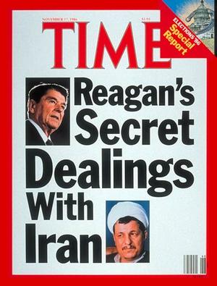
The Iran-Contra Scandal
Iran-Contra was the only scandal to “stick” to Reagan, at least temporarily.
Reagan’s approval rating dropped from 67% to 46% during the scandal, but was back up to 64% by the time he left office.
It resulted from Reagan’s desire to free Americans held hostage by terrorists in Lebanon, and from the Boland Amendments, which prevented U.S. aid to the Contras in Nicaragua (Contras were fighting the communist Sandinista government there).
To find a way to keep helping the Contras, Reagan’s CIA head, William Casey, devised a plan for indirectly funneling money to them.
Notes:
Casey was never indicted in the scandal because he died May 6, 1987 (the day after Congress began the Iran-Contra hearings).

Slide 32
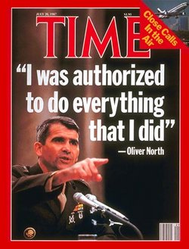
How the Plan Worked
In 1986, U.S. gave weapons to Israel, which sold them to Iran.
Iran used influence to get Americans taken hostage by Hezbollah in Lebanon set free.
Iran paid Israel for the weapons.
Israel put the money in a Swiss bank account.
Money from the Swiss bank account paid for aid to Contras in Nicaragua – this violated the Boland Amendments.
Notes:
It was also illegal to funnel weapons to Iran because we had an arms embargo against Iran.
Originally, this plan was only to free American hostages, but Oliver North added the practice of diverting money to the Contras (because the middleman had overcharged for the weapons to Iran, so there was money left over – North decided it would be a good idea to use the extra money to help the Contras).
Congress had finally approved $100 million in aid to the Contras in 1986, but since the Boland amendments were still in effect when this plan began, the plan was still illegal.

Slide 33
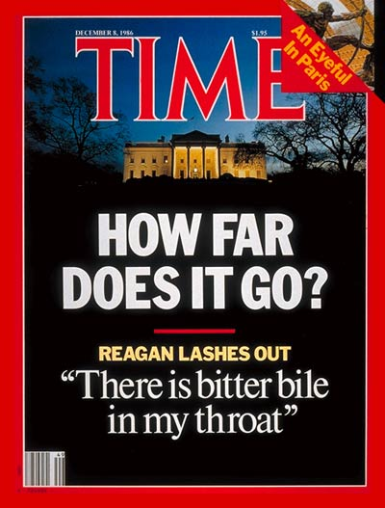
How it became a scandal
The Sandinistas shot down a plane delivering weapons & supplies to the Contras – surviving crew member was ID’d as working for the CIA.
This showed that the U.S. was aiding the Contras (which was illegal under the Boland amendments).
Reagan had not ordered the “arms-for-hostages + money to the Contras” deal and did not know it was even going on until afterward – but was criticized as it being his fault because he’d encouraged his administration to find ways of helping the C0ntras.
Notes:
The CIA plane was shot down October 5, 1986 – the surviving crew member was Eugene Hasenfus.

Slide 34
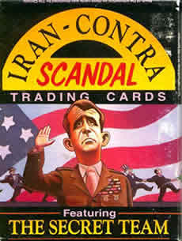
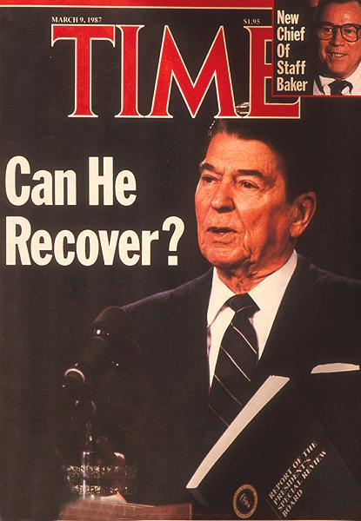
The Iran-Contra Investigation
Reagan appointed the Tower Commission to investigate Iran-Contra.
In the end, 14, Reagan officials were indicted, including Sec. of Defense Weinberger.
11 were convicted, including National Security Adviser John Poindexter & Col. Oliver North – but both their convictions were overturned on appeal, and the rest were pardoned later by President George Bush.
Reagan was found innocent of involvement in the scandal.
Notes:
The Tower Commission was formed Nov. 26, 1986 and consisted of former senator John Tower, Edmund Muskie, and Brent Scowcroft.
The Contras were hardly angels – although anti-communists, they financed their operations via drug trafficking (California’s crack cocaine epidemic was supplied by the Contras). The Sandinistas also accused the Contras of murdering prisoners, rape, etc. The Sandinistas also committed atrocities – hundreds of Nicaraguans were jailed by them each month, about half of whom “disappeared” (executions, mass graves, etc.).
In 1990, Sandinista leader Daniel Ortega lost in the Nicaragua elections and the Sandinistas lost power.

Slide 35
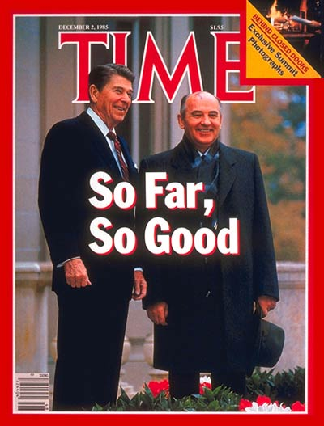
Reagan and Gorbachev
Reagan met with new Soviet leader Mikhail Gorbachev in Geneva in 1985 and again at Reykjavik, Iceland, in 1986.
Reagan wanted to reduce both sides’ number of nuclear missiles.
At Reykjavik, Gorbachev refused to deal unless U.S. also got rid of SDI (Reagan’s “Star Wars” anti-nuclear missile system), so Reagan walked out without a deal.

Slide 36
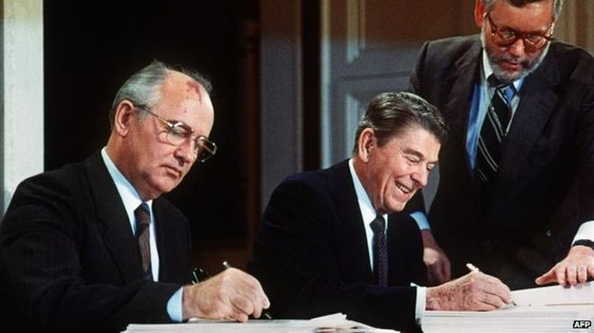
Reagan Wins
Reagan’s strategy of spending the Soviets into oblivion worked – the USSR was going broke trying to both keep up with the U.S. in the arms race and reform itself politically.
By 1987, Gorbachev was desperate to make a deal and agreed to do so even if the U.S. kept SDI.
This led to the 1987 INF Treaty – the U.S. and USSR both got rid of all intermediate-range nuclear missiles (and the U.S. kept SDI).
This was the first time the number of nuclear weapons had actually been reduced.
Billy Joel’s “We Didn’t Start the Fire” captures many of the world’s major events from the Cold War era: https://www.youtube.com/watch?v=cDPnsTRAvIM

Slide 37
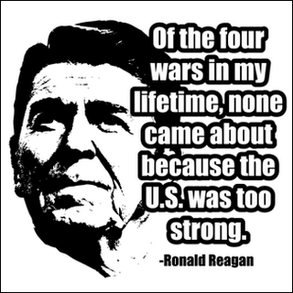
Reagan’s Legacy
Pressure by Reagan had encouraged the Soviets to reform and make the USSR more open to the outside world – Gorbachev called these reforms “glasnost” (openness) and “perestroika” (restructuring).
The Soviets were going broke trying to keep up with our military spending; instead of saving the USSR, Gorbachev’s reforms exposed communism’s flaws & caused it to collapse quickly.
In 1989, the Berlin Wall came down – the symbolic end of the Cold War.
Communist regimes of East Germany, Poland, Hungary, Bulgaria, Czechoslovakia, and Romania all collapsed.
The Soviet Union itself collapsed in 1991.
Reagan’s legacy: he won the Cold War and is considered one of the 10 best presidents ever by historians.
Notes:
Pope John Paul II also deserves credit for winning the Cold War – the Vatican backed the Solidarity movement in Poland and provided intelligence to the U.S. Gorbachev himself said the end of communism “would have been impossible without John Paul II.”
Communism fell peacefully in Czechoslovakia (the “Velvet Revolution”), violently in Romania – where dictator Nicolae Ceausescu and his wife were executed.

Slide 38
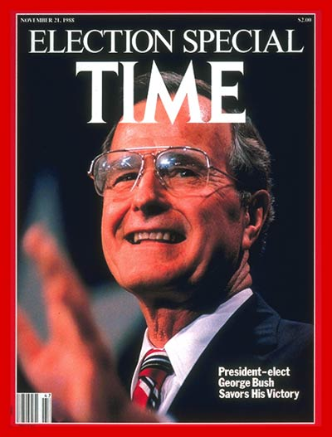
President George H.W. Bush (“Bush 41”)
Republican (had been Reagan’s VP); won bitter 1988 election over Democrat Michael Dukakis. https://www.youtube.com/watch?v=Io9KMSSEZ0Y
Lost his conservative base by breaking “no new taxes” promise when faced with $500 billion Savings & Loan crisis and $200 billion in nuclear waste cleanup.
Approval rating reached record 92% when U.S.-led coalition defeated Iraq and drove Saddam Hussein’s forces out of Kuwait in early 1991 during Operation Desert Storm.
But economic recession in 1992 left him vulnerable in race for reelection.
Notes:
This video clip is about 40 seconds long. Willie Horton was serving a life sentence for murder (stabbing a 17-year old gas station clerk to death in a 1974 robbery) with no chance of parole. In June 1986, Horton got a 48-hour weekend furlough from a Massachusetts prison under Governor Dukakis’s furlough program. Horton never came back to prison – he disappeared until April 1987, when Maryland police arrested him after he’d raped a woman & stabbed, beat, and tied up her fiance after breaking into their home. As of 2010, he was in a maximum security prison in Maryland. The Bush “Weekend Passes” commercial was criticized by Dukakis supporters for several reasons: “They weren’t really weekend passes – they were 48-hour passes – he was supposed to be back to prison by Sunday night, not Monday morning!” Also, complaints were made that it was racist to show Horton’s picture (because he’s black) and to call him “Willie” (sounds black) instead of “William.”
The Persian Gulf War ran from August 2, 1990 to February 28, 1991, starting with Saddam’s invasion of Kuwait. Aerial bombardment in Operation Desert Storm began January 17, 1991; ground assault began February 23, 1991, and all fighting was then over within about 100 hours. Coalition casualties = about 1,200 (379 killed) vs. 35,000 Iraqi casualties. Iraq tried to draw Israel into the war by launching Scud missiles at Israel, but many were shot down by U.S. Patriot anti-missile missiles, and Israel stayed neutral. Iraq was hoping that Muslim coalition partners of the U.S. like Saudi Arabia would leave the coalition if Israel joined the fight on the U.S. side. By the way, a major reason Osama Bin Laden declared jihad on the U.S. was that we “desecrated the land of the Prophet” by stationing military forces in Saudi Arabia during Desert Shield and Desert Storm.

Slide 39
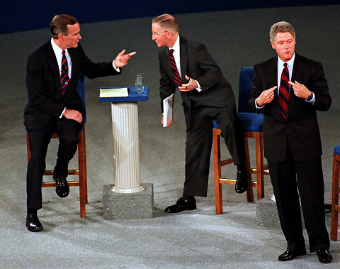
1992 Election
Three-way race: H. Ross Perot challenged President Bush as a third-party candidate & won 18% of the popular vote; Bush won 37%; Democrat Bill Clinton won only 43% of popular vote – but that was enough.
Clinton won 370 electoral votes to take the election.
Clinton focused on criticizing Bush’s economic problems.
Almost all Perot voters would have voted Republican if Perot wasn’t in the race – even though Perot won no electoral votes, he had a major effect on the elections outcome – basically, he ensured that Bush would lose!
Notes:
This photo captures the whole ‘92 election in a nutshell – while Bush & Perot wasted their energy fighting each other, leaving Clinton free to win the election by saying “it’s the economy, stupid” and playing his saxophone on TV talk shows!

Slide 40
President Bill Clinton
Winning only 43% of the popular vote meant that President Clinton didn’t have a strong mandate from the people.
He was hurt by character issues: accusations that he was a draft evader during the Vietnam War, admitted marijuana use in the 1960s (but claimed he didn’t inhale!), and “bimbo eruptions” – scandals about extramarital affairs.

Slide 41
Clinton’s Presidency
Raised taxes but also cut spending.
Appointed wife Hillary to create national healthcare plan, but it failed in Congress.
Had to become more moderate as Republicans took control of both houses of Congress in 1994 and promised to cut back on government & balance the budget with their Contract with America (led by House Speaker Newt Gingrich).
Reformed welfare (along with Congress) in 1996, putting limits on how long people could stay on welfare.
Economy did well until late 1999, when recession began.
Notes:
When Republicans basically forced Clinton to reform welfare, he announced that “the era of big government” was “over.”

Slide 42
Clinton’s Problems
Clinton was reelected over Republican Bob Dole in 1996, but had many problems.
Terrorist attacks increased during the Clinton years: World Trade Center bombing in 1993; Oklahoma City bombing in 1995; U.S. embassies in Kenya & Tanzania bombed in 1998; USS Cole bombed in 2000.
All but the Oklahoma City bombing were carried out by Osama Bin Laden’s Al Qaeda terrorist network. OKC bombing was done by anti-government extremist Timothy McVeigh (later executed).
Several scandals: biggest was Whitewater (land & loan fraud in Arkansas) – Special Prosecutor Ken Starr’s investigation uncovered Clinton’s affair with White House intern Monica Lewinsky.
Notes:
There was also the attack on the Branch Davidian compound near Waco, Texas – ordered by Clinton’s Attorney General Janet Reno – that resulted in many deaths. Other Clinton scandals included Travelgate and the death (suicide? murder?) of Deputy White House Counsel Vince Foster in 1993 – one theory is that Foster was having an affair with Hillary Clinton that led to Foster’s death.

Slide 43
Clinton’s Woman Problems
He (eventually) admitted to affairs with Gennifer Flowers and Monica Lewinsky.
Was sued for sexual harassment by Paula Jones.
Kathleen Willey & Juanita Broaddrick both claimed he sexually harassed or assaulted them.
Elizabeth Ward Gracen, Sally Perdue, & Dolly Kyle Browning all claimed to have had affairs with him.
When his wife Hillary ran for president in 2008, two more possible affairs were reported.
Notes:
The two reported affairs in 2008 were actress Gina Gershon and an unnamed member of Canadian Parliament. Oddly, Bill had alleged affairs with two actresses who were both in Steven Seagal movies (Gershon and Elizabeth Ward Gracen) – not sure what that means, but it’s something. ☺

Slide 44
Clinton is impeached
Under oath in the Whitewater investigation, Clinton said he had not had sex with Monica Lewinsky.
DNA evidence later proved this to be a lie, so Clinton had committed perjury.
Late 1998: the House impeached Clinton for perjury & obstruction of justice in the Whitewater case; he was acquitted by the Senate, but his reputation had been further stained.
Clinton is ranked by historians as an average president – in a 2000 C-SPAN poll, he was ranked #21, one spot behind George H.W. Bush at #20.
Notes:
Clinton launched cruise missiles at Iraq on the day his impeachment hearings began – critics saw this as a diversion from his political trouble, not a legit military action.
Clinton was also criticized for pardons issued just before he left office – mainly Marc Rich, a billionaire whose wife Denise had donated $450,000 to the Clinton Presidential Library fund. In 1983 Rich and partner Pincus Green were indicted on 65 criminal counts, including income tax evasion, wire fraud, racketeering, and trading with Iran during the oil embargo (at a time when Iranian revolutionaries were still holding American citizens hostage).^{[3][9]} The charges would have led to a sentence of more than 300 years in prison had Rich been convicted on all counts.^{[3]} The indictment was filed by then-U.S. Federal Prosecutor (and future mayor of New York City) Rudolph Giuliani. At the time it was the biggest tax evasion case in U.S. history.

Slide 45
President George W. Bush (“Bush 43”)
Republican; son of President George Bush; defeated Democrat Al Gore (lost popular vote but won electoral vote after controversial recount of votes in Florida).
Presidency was defined by 9-11 (September 11, 2001 terror attacks), which led to the War on Terror and Operation Iraqi Freedom.
War on Terror began with quick victory over Taliban in Afghanistan in 2001; Bush’s approval rating soared over 80%.
Operation Iraqi Freedom: U.S. quickly defeated Saddam Hussein in 2003 but then struggled to control terrorism in Iraq.
9-11 news clips: https://www.youtube.com/watch?v=brSVsP2NUbs
Notes:
This video clip is about 6 minutes long. Bush was criticized because WMDs weren’t found after Saddam’s defeat, but virtually everyone had assumed there would be WMDs in Iraq – the Clintons and several foreign intelligence services had said that Iraq had WMDs.
Saddam was captured December 14, 2003 and hanged by the new Iraqi government on December 30, 2006 for crimes against humanity.

Slide 46
Bush 43: The Rest
Reelected over Democrat John Kerry in 2004.
Signed No Child Left Behind law (sponsored in Congress by Ted Kennedy) – tying school funding to test scores as first suggested by President Clinton.
Proposed to reform Social Security (failed in Congress).
2007 troop surge in Iraq succeeded as Iraq became safer & more orderly until most troops were later pulled out by President Obama.
Recession began in 2008 – bailouts of banks & automakers “too big to fail” cost taxpayers hundreds of billions of dollars.
Left office with approval ratings under 40%.
Notes:
The 2004 election was described as “Bush vs. Bush Light” because Kerry seemed to agree with Bush on most issues, but somehow argued that the same actions would work better if he was president than if Bush was… just because it would be him instead of Bush.

Slide 47
President Barack Obama
Democrat, elected in 2008; first black/biracial president.
2009 economic stimulus bill cost nearly $1 trillion but economy did not improve.
Controversial health reform law (Affordable Care Act, or “Obamacare”) similar to the one that Hillary Clinton proposed in 1990s passed after long debate in Congress.
Major criticisms: he broke Bush 43’s records for highest deficits, most national debt, and most Americans on food stamps.
Where does he rank among presidents?
Notes:
By 2011, 45 million Americans (about 1 in every 7) were on food stamps.
To answer the “where does he rank” question: C-SPAN’s poll of historians, political scientists, etc., places Obama 12th, below Reagan, JFK, LBJ, Ike, Truman, etc., but above Bill Clinton, Andrew Jackson, both Bushes, etc. However, Dr. Vern Pedersen ranks Obama as comparable to Jimmy Carter, which would place him somewhere in the #25-35 range (out of the 44 presidents up to and including Obama, chronologically).

Slide 48
Getting Bin Laden
Three presidents had tried to kill or capture Al Qaeda leader Osama Bin Laden.
Bill Clinton has been criticized for not getting Bin Laden and preventing 9/11 – he counters that he tried, but Bin Laden was always lucky enough to escape.
George W. Bush spent massive resources hunting for Bin Laden after 9/11 – many Al Qaeda were killed or captured, but Bin Laden continued to hide/escape.
May 1, 2011: during the Obama administration, Navy SEAL Team 6 killed Bin Laden after intelligence found he was in a hideout in Pakistan (near the Pakistani military academy!).
Robert O’Neill of Butte, Montana was the SEAL who shot Bin Laden.
Al Qaeda and ISIS still continue to be major terrorist threats.
Notes:
Since O’Neill’s claim, other SEAL Team 6 members have also claimed to have shot Bin Laden.
Per Dr. Vern Pedersen, the former Pakistani ambassador, when instructed to chastise the U.S. for intruding on Pakistani territory to get Bin Laden, asked whether he should express Pakistan’s anger at being shown to be incompetent in not knowing that Bin Laden was hiding just a mile from their military academy – or anger at being shown to have been secretly hiding Bin Laden and the U.S. getting him anyway! He hinted that the latter case was the truth.
As for ISIS – two important things to know: 1. Unlike Al Qaeda, ISIS must control territory to exist – to have an “Islamic State.” 2. ISIS believes that their conflict will end when they are near total defeat in a worldwide war vs. the infidels – when there are only 5,000 ISIS fighters remaining, Jesus Christ will return to Earth, destroy their enemies, and they will rule the world. Is it possible to negotiate a peaceful resolution with an enemy that operates under this belief? I don’t see how it is.

